Slide 1
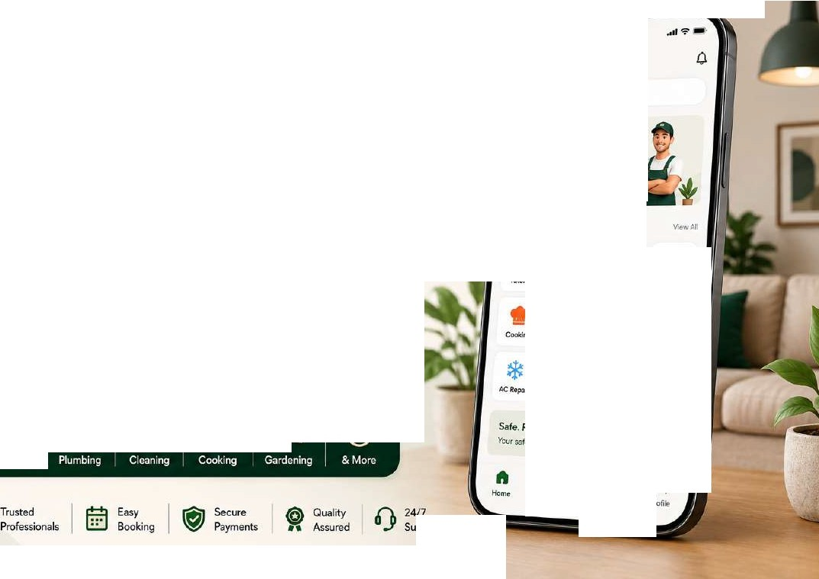


...
Trusted Professionals
R91tatYourDoorstep
Badt_--...Jrf'o'"
....
Popular s.rvice<
_.,. .,_-,g&
-
SERVICES THAT coME TO '{OU
'Sr
�
�
•
Every Service. One App. Your Home. Our Priority.
UKODO connects you with trusted professionals for all your home needs - quickly, safely
and hassle-free.
T_.,.
fj
�
p�
�
.,_.
.........,
...........
U:h;m'*
�
c.-w..h
••
Mc,,,
8ati,o;.,;,,g
e
Safe.Reijable. Verttied.
YQ.;r seftty sour pnor(Y,
fll El
�
0
a.
@ Quality
•• Assured
n 24n
(.i;, Trusted
!!::!\ ^{Easy}
Sec.u'"
Payments
u .Y Support
V!fit/ Professionals
_{U!:.J} Booking

Slide 2




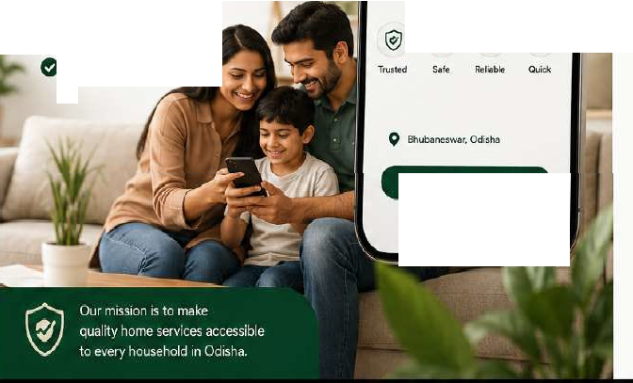

Services We Offer
"
1-6\
J.:
- SIAVICIS THAf COMITO YOU-
•
••
About UKODO
UKODO is an oo-demand home services platform that connects trusted professionals with households -
quickly. safely. and seamlessly.
0 Trusted Professionals
0 Easy Booking
0 Secure Payments
0 Quality Assured
0
•••
Home Tutors
Plymbing
Electricians
House Cleaning
-
\\\
c::all
Every Service. One App.
Your Home. Our Priority.
�
�
�
Laundry& Ironing
�
,,
Home Cooking
Gardening
�
Painting
.,
1111
c-)o
Car Washing
�
Carpentry
*�*
AC&
Refr1gentor R-i,air
• ·•-
Bd•rCare
••••
PetCMe
•••
& More
Get Sto-tcc
Babysitting GeneralHelp
•
Log n / S,gnUp
@
Background Verified Professionals for Your Sofoty and Peace of Mind.

Slide 3

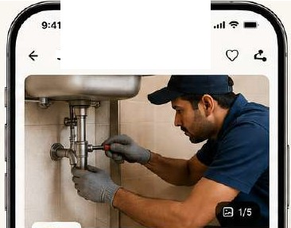

-
II
Service Details
9:41
-
A
Provider Profile
- SERVICES THAT COME TO YOU -
Ravi Plumber $
* 4.6 (128Rcvicw:s}
Service Details
View complete service information, check pricing, read reviews,
and book with confidence.
Plumbing Specialist
500+ Booking.s
...
Ea B• C 4.6♦
(!) 98%
On-tlmo
© si.,i-..w., Odt�h::i
YoartExp.
......
-
-
Customer Revi@.ws
2;, -•
SeeAII
4.6
'"
92
24
Plumbing Service
fr)Cingleak$, pipa install.zition.
bathroom fittings& more.
4*
Detailed Information Know more about theservic,e and what'sincluded.
i
......
3 ..
(128 Reviews)
1* •
@ V.rifiod
•
•
•
G
Transparent Pricing Clear andupfront pricing withno hidden charges.
About Service
Our exportplumb.grsC-'f'Ih8lpyouwith all fypQSof pll..WYlbing issJ.Jes including krak repair$, ..,ip�in-1.tallaliM, bathroom fittin95-, tankdeaningandmen!.
RQ,jdMor�
Ashish PateJ
2 Moy Z02'1
Great service! FiJ:ed the leakquickly and veryprofe-ssionol.
Ratings& Reviews Read genuine reviews from real customers..
Sneh; Mohanty
28Apc2024
What'sIncluded
0 Leak detection & repair
IO Pipe ir"l$tallotion & l'epl�c,ement
0 &throom & Xitt.Mnfittings
0 WIJter tank cleaning
0 General plumbing maintenance
• ••
Good work ::ind boh:)viot.On�tlmo and reasonable charges.
Verified Professionals
Allprofessionals arebackground
verified for your safety.
Rake
sh Behera
20,..,,2024
•••••
Quality service you can trust,
professionals you can relyon.
Vcryh�py withtheSCNicc,Highly
rocommondcd!
5tar1ing From
f299
Setviee at your OOontep
Book Now
t299
Starting From
Book Now
•
B.ickg�cunci
0
On-time
®
Set.:ur0
L. 100%
.,
Venfled
Service-
P
a1ments
I•
S<1t1s�act10;,

Slide 4
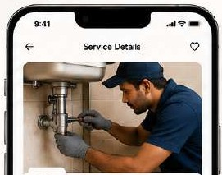



II
�
Easy Booking in Just a Few Steps
Book any service, any time - Quick, Simple & Reliable
�
UKODO
- 5tRVICfS llU,T COME ro YOU -
••••
0 Choose Service
Select Date & Time
E) Confirm Booking
0 Make Payment
f-
Sele-et lhlte& Time
E- Confirm Booking
f-
Payment
"
LJ?.f_!
Select Oatit
Moy2024
Plumbing Servica Fixing l«I�pipe,11-,�tlon, bathroom fittings & �re.
?319
""' '"" w..a Tho F1i
'"
'""
'"
6
30
•
•
Book.-ig Oeta115
16Me,2024
10100 AM - 1'2!00 PM
Choose Payment Method
..._ Plumbing Service
i 4.6 (128R�·s)
AboutSsrvice
Our expertplumb8f"Scan helpyouwith all typBi of plpmr.ino l�$1.1es lnc:u:finoleekrepairs. pipe installation,.bathroom fittil'lg&.taiik cloanrig and
fl"IOr'I!_
Pri¢0
f299
13 14
15
10 11 12
17 18 19
e
UPI
�uwig;anyl.R�
20 21 22 23
24
25 26
Add�
Ptot No.123, S3hi1d Nagar.
8hlber1e$N&r, Od�a - 751007
0
ca..t,
Oocil/CrtdltCardo
cij
27 28 29 30 31
Prcvldor
ft RaviPlumber
� •4i.6(128�s)
0
NcltBanking
AJl�o·banki
....
Selecrt ,me Slot
11-i+fri
2:00 PM
!!!
9:00AM
11:00A.\1
Prfc:eDetalls
l299
l20
₀ Wallea
IE
m
1:00PM
3:00PM
Scrvi:eChOll"ge
Pl-1tfom,fec
P� Pl-o.11e�Arroi,zon Pfl'fetoe.
_{Cl} Ca$h M Serviee
4.00PM
5:00PM
6:00PM
Total Amount
?319
P'to1tftcrthc�r,i;;c
Continue
Continue
Conf
i
rm Booking
Pay n19
Trusted Professionals
�
Easy& Quick Booking
Payments 0
Secure
On-time Service
24/7
Support
Satisfaction
Guaranteed
8

Slide 5




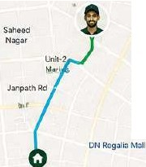
�
/�
UKODO
- SERVICES TH1'T COM( TO YOU-
Track Your Booking
--- ...
Stay Updated, Stay Relaxed
e
Real-time Updates
f--
Booking Details
Help
Live Tracking
Chat with Ravi
Get notifiedat every step
800.k!ng 10 #UK0204516
111Progrtts
Ravi Plumber
4.6 (128 Re·.r!ews)
Hello Ravi. when will you reach?
09:dO.O.M..U
•
of your booking.
Live Tracking
Track your professional in real-timeon the map.
Plumbing Sorvico
filling l&.ak.s:, pipeiMta'ilatiOI\
ba1hroom fittr!Q!i & more.
On the Way
Arri'AnQin 12 min, (2.3km�wsyl
Hil rm on my wayand
winreach in 12 minutes.
O!MIAY
•
ffi Date
(!) Tlll'I�
(:) Addr-es:s
16 May 2024
AG Squorc
lOW AM - 12·00 PM
Great, thank you!
0911!;1 ll.M.J'/
Easy Communication Chat or callyour service provider anytime.
Ploi No. 123, S.'lheed Nagar.
Shu�, Odlffl:ii• 75l007
I
KJIT
Squdf8
Booking Prognti5
Sorvic11Stanod
I0,02AM
Booking Confirmed
16 M.y 202A, 09�30.Mt
'Nork completed
5-ucces.sfvlly,
111S'-JJ
Total Transparency Know when your service starts and ends.
Prof�tOnaf Assipd
16M.Jy2024, 09:35M1
OntheWav
16"'.ay 2024,09:45Mt
Prof�ssional Details
Experience
e..-Years
Plumbi�,Pipef'11ting, Bathroom Service$
Thank you for the great service!
Your Safety is Our Priority Allprofessionals arebackground verified for yourpeace of mind.
S&Mce Started
�cim.,.ted10:00 AM
CancelBooking
Vehick,No.
OD02 AX 1234
Type 3 message...
Background
Verified
On-time
Service
Transparent
Pricing
Secure
Payments
24n Support
5-Star
Service

Slide 6



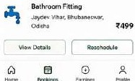
Provider Dashboard
Manage Bookings, Grow Your Business
• • •
UKODO
- SliR:VICliS rMAT COMli TO YOU -
�
Everything You Need
to Succeed
�hboard
0
Booking$
Eemings
0
l!,I
�
A
My Profile
rt
e
.
Manage Bookings Aocept, res.<:hedule or complete bOokings.eaidy.
Ravi Plumber0
�u!l"lbingSfx,ciiciili,.
.4.i(l'Z8�0wt)
TinMMCtl.,.
ID
Ravi Plumber0
Plumb!A9S��
4.61128 A:el,,le,,.s)
16 IJlo.y 202A • 10;00 AM
� .._,
T91elE1mlr,115
f24,680
To111l[mnm'.J\
,,.,/
tl8%w�rncnt11
--
Of)IJ"o(I I
Track Earnings
Monitor your iicomeand
W:thdrawanytime.
t24,680
- -
"•·-· :e;; a
t20,320 t3,360
tl,000
""'
E
�1'/Sffllic«
l'lurrtlffiO. l>!l»fln.LfllJ ■IIT'f'lnm
h,c Unrth
t 1�•-. .r.r�• mt1,,.h
�11,Eirflll>I»,
_{t:,} A"d11bifty
e e e
128 12
◄.611 98%
Eamiog:,Ovesvit!w
Ratings& Reviews Bi.ild your reputation with happy customer,.
"°""""" "'"""'"'
Upc:omin9 Bookings
....,
11Moy2024 • ?.OOPM
"1,,..,...
1'<
I I I I II
m
El
Mon-$1111• l:OGA.\t-t!C(IPM
..
Ool:\lm•nt,
&tchNr,?.\"-4£:,pe,,iJlf",e,tC..,
"'
U(
8�n�OP�11;
HPFC:••ni •-• IU"
Today,14May
10:.00Al.l-12:00PM
1'kll.N.o..�3.S»IHd�ll(;Jllt,
S�ub,a....t,-.W, Odl�U
-
1i">, 1iMt.., OM� """ 1$Mf) VMty
* ,�e,Al..,1�-
Set Availability
Choose your working houn; and got morebookings.
Recent Tmn:lilclioru
S.,AI
�views
alt
18Mo7f2024• l't:OOAM
� ..lid
"t
PIYr!!.b.hg�o | ..,299
1,r.M� 1.0U.'QOO.6M
&rthroornfitting 1'M•\�?&,�..))Pt,1 | .,.,499
Plpef!•,,_.it | f199
t1Mq:tol4,t1:CIOA.1,'
(1) l-letp& &.;pport
Profile Management Updste yourprofile, services and documents.
TCfflOl'l'hl,17"1�
2:1:)0P!'IA .. 4:00PM
"'
$ ^{Sellk)g!o}
KUTRti-itd.P.. tu, Bh.btneWfltJ
_{G} logout
- -
"1
a>
--
1111 G'I
0
""""
..^{f},^{l.}...
lli!l
lkl<llu!a,:
0
g
C-:l
@
lc>c>ill!\11
0
:.
VerifiedProvider•
Bvitd Trust. Earn More.
_,,,,
0
Verified & Trusted
Get verified and stand
OVl from the reu.
More Bookings
Get more jobswithbetter
visibility.
Grow Your Business lncreo9e earnings and
buld yourbf-and.
L9
Easy Payouts Withdrl:t'lov your eamings quickly andsecurely.
24/7 Support
We'rehere to help you anytime, anywhere.

Slide 7
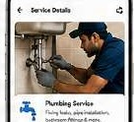



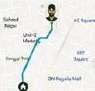


¼
UKODO - Services That Come to You
On-Demand Home Services App
II
UKODO
UKODO connects trusted professionals with homeowners for a wide range of
- SUVICU lHAT COME TO YOU -
-..
-
home services- quickly. easily, andreliably.
.u,
A Seamless Experience
Problem
--
..._...............
t
Business Model
FindingrdrClbleOfld:Jii1ed
�9..1??
......_._
COnlmssion on every
booking (10-20%}
homes.ervica prcteuiionab
"'"..........,
•
lit tlme-con11uroi"9 and
..^{C}...^{l-}.•..•.⁻
unrclhable.
"' "
•
...........
Howwa$:your
experience?
.*...
MfMHI
5'.Jbscription plan.sfor
servic;:e prtrlider!i
Solution
UKODOofferae on-e-stop platfo.-m to boo�verified profcisionob forol home
st.><vices111tdiE'a5e
1li
* '
�
F�twed listing$
₋₋....._₋
f;i :!
...-� ·----·-
Em.ergt:ncybooking charges
"'"-_.....,._-.._
....
.1oo1.-�-
Mombership plans for
cu�tomers
e Target Market
Working�onels
Studentt & famll�
Elderly& bus.y
individuals
c,i...i.-�...-
·-----
.,
,..,.,......,,
•••
·l'\,o-li--
flN"J:l))l.«r
.
0-_- .........
r---� :
.^{A}. ii
Markel Opp<>rtunity
-
- -
Cl (),o,,vi�d•rn,11•1d fcr-hotr-ie st!r'lnt"1f?1f11dlcll
A Cl 0 ...
Mh:fh··· rM
....
1
G Urge�ad�MC@ pro,,ldernuritet | HomeScreen | Servic.eDetail:s | Bookingflow | LiveTrac.king | ln-AppO,-,t | Reting�& Review,
0 �ngSR1,wiphon11 | b;pbre seMOO!i | V1ew,come>are and |  | Tr:acic� profo�i:ii,na2 | ComrrunC.ateeaslly | Rateand teviEw
a,,dlntl}fflet l)e'le1r-1ti�
andoffers
(h>ose,en,ices
andcmfirm
inreal-tim�
andsecurely
th6tie,,..i«!
Key Features
Technology Stack
Launch Roadmap
₀ ,.....,
□:=re
@f
Real·tlme
Tm:khg
0 Paytn&n.18^{s.c,,,r.}
�
Frontli!nd
{
Ao""
Bad<end
Oatabas@
�yments
Map<
Q
"""'1•-
Fi�ba,eC!ood
MHUg!rtg
ft A , -�
��
2
�or»b
*..........
M..o.n.g.o.D..8/
/;Razorpay
(9
lfl•AppCMt Rfllingt&
@
sos
&,tto,
M,)1H111·�1,1.-
Si.ppcr!
RreNc.ef
Nodl).j:
-·
4
6
Growth&
E:r.panEion
laCalng
l.)?l,W,itco
Planning&
.._,,ch
UINX
Design
(0
i
i
. I
Q
Our V1s1on Tobecomelrd1a·smost trustedhome services platform.
OurM1ss1on: Tomakerellab!e come serv | cesaccess | ble to everyon | e anytime. anywhere

Slide 8



#i.
Why Choose UKODO?
Smart. Reliable. Convenient.
�
UKODO
- SERVICES THAT COME TO YOU -
Whlit.serv-ice do
UKODO is more than just an app - it's acomplete home services solution
designed to make your life easier every day.
m
t]
..,
·"'".' .
C, Revenue Streams
A Trusted Professionals
Allservice providers arebackgro1J11d
verified andskilled.
•
0
f-
Sookfng Confirmation
F"9:41 -
..-1-,.•
�All'lltl
� MyBooklns�
Commission on every booking
(10-20%)
Subscriptionplans for
service providers
Featured Iistings for
better visibility
Emergency booking charg•s
Membership plans for customers
On-Demand Convenience
Book anyservice, anytime, from anyi.vhsre.
you neodtoday?
Your bootingi•corrfirmcad!
'61
,...
Q�'6r-�(-
Pl....,.it"'9s.ivi"
e�..
...,
<-•
......
1/1,t,W� t... <UiOl1' lO�.-i
1,"'°'":m<l·iO;OOAM
ri1
II
°"""""''
�
"
--
Wtd�n11n'lll!t.
�
-^{'3!il'O}
.
Pli,1mb119 Se,v;ee
'-iMmi?Ot••�oc>.atJ-,too�
t\at�.12,l11'-d.No;or.
lhbln.n,,Qt,Odi<.111• 7!i100,1'
Multiple Payment Options Pay onfine, p,;tf late<or in cash - ycur choice.
'1,rftNiQ c��
, ...,...
1-b,,,•CIHl'l"-;JI
_{-�-} l7Mov3l'2'4·�.00PM
....
$ ·I·
�
�
Quality You CanCount On
Ratings. feviews& customer reedbad
ensure top•qua:lity servlC@,
R.AT20%CH
o,�l!mij,g
[ IK)()(MOW I
tit
.s.
�Tutonftt
IIW.�•"l:001...,,,.
...
•
U-:020-4513
...,......
0 Safety & Trust
IJ
Re,;,;,,,uf1111Qldk>r-"°"
"""'""
^{l} '*' ^{I}
.,..,_
.3.,
_{I} ..... ₁
fl Background ve<iflcation
•
24n Support
We'realwayshere to help
youanytime, enyvifflere.
I_
H,_,_
-Si.,tt:V-'�"
i
�
...·��
"lO''r-of2D?••;tOli�""'
0 ID& do::urnent verification
0 Live loCi!lltlOn b'ackirl(J
0 ln•app SOS button
0 Secure payments& data protection
, lil.6Clltl
..•..... ⁰
.{.:.} .
Best Offers & Discounts Enjoy exclusive deals, coupons and referralre.vards..
.....^{f}..^{t}... ...^{I}.^{l}.^{l}.]..
g
₍�-------------------------------,
0
Our USP
_{I}',Q
Starting fromCutt.ick
& Bhubaneswar, Odish�
Expandingto Eve.-yCorner
oflndial
I
All-in-Ori�
Pl�tform
Ve.-ified &
Truoted
Transparent
Pricing
Quick& Easy Booking
High OJ$:tomer
Satisfaction
'
Local Focus
'
1
'^{O}
'
0
Global Vision
- - -
- - - -
I
I
Start Local, Go GlobalwithUKODO
Empowering Homes. Supporting Professionals. Building Trust.

Slide 9


The Future of Home Services is Here
Empowering homes. Supporting professionals. Building trust.
--•••--
�
UKODO
- SERVICES THAT COME. TO YOU -
�
" UKODO is on a mission to become India's most trusted home services platform.
Revenue Model
e e
8
Market Opportunity
CommlsS.on on &Very booking
{1�20%)
Huge & Growing Market
T� h.Ol'M�ervkes:m� In ltld!-a
is '!70Wingf'apidly.
How UKO0O Works
Subscription plans for
service providers
lnc:reasing Demand Urbaniu,:t;ic,ri, bu$ylifestyle3 ,md duaJ..incoma housaholds an! dr/Vir'lgderr'l&OO,
@-1
····-+
0
••••►
••••►
-
FeaturedIistings for better visibility
Digital Shift
Moreusersare turning !O OPPS to book t�ted professbr.als. onlinc,
0
Choose Seniice
Sele<;ithe service you nQl&d.
e
Book & Schedule
PICI,:date & time:
that suitsyou.
e
Professional Arrives
Verrficd profes$ional
arrl\14:>Son time.
0
e
Pay & Relax
Makesecure payment
and rate your service.
Emergency booking charges
Service Completed Worki�comp1eted with q¹Jallty.
Membership plans
for customers
Fragmented Industry Highly \Jn01"9anized market with lackof tran5'larency and stardatdlzation.
Our Key Services
Why Partners Love UKODO
0 Mo� bookings:& better i()Co1ne
0 Tr311spanant & tlmQfy payments
0 Lowcommission & high returns
0 Growth tools & busines$ support
0 Trusted by thousands of pros
G
UKODO Advantag., Technology�driven platfonn solving real problems with trust ;md convenience.
••
&Many
Mor•
.•,•.
0
Ph,.1mbing
E1ectric.il
c�rpentry
P.illinting
.
10,000+ Happy Cu�omers 100% Verified | 2,500+ VerifiedProfes.sionats | ₁₁ 50,000+ ServicesCompleted ₍₎ 24n | 4.8/5 Average Rating Best Offers& | _{ili} 15+ C�ies Covered Quality | Stat'ting from _{Q} Cuttack & Bhubancswar, l 9, 9
Professionals | Payments | Support | o-iscounts | Guaranteed | �:;�:1 1:i:�ery
*
:'
0
Secure
Odi$h3
;
I
'
� Think Home Services. Think UKODO.
]
Q
Together, Let's Build a Smarter. Stronger India

Slide 10







#l,i.
UKODO - Business Model
Building a Sustainable & Scalable Home Services Ecosystem
-- ·••--
UKODO creates value for homeowners, professionals, and partners through a seamless technology platform and sustainable business model.
�
UKODO
8
- SERVICES THAT COME. TO YOU -
Problem
Finding rebbte, $killed & "1erified homeservicepro1e,sion.ils
is tiirne-oonsuming iiH'td
unr@li&bl".
•
0
l=l
I>
Revenue Model
Business Model
Key Partners
0
f8>
Com mis.sion on Booking:S
Payment
Gateways
lnsu,anco
Partn&r$
8
Our Solution
Ut<O0Ois an oll-'1-one platform that coooectscustomers with trustedprofessional�for 811 homeservices. - Guickly, etl.Sily& $CCtirely.
0
0
0
8
10%- 20%on eve<ybooking
Subscription Plans
For servic:eprofessionals (PffMYlium listlng:s& leadi.)
Tool& Equ;pment Supplier,
Tr•Jning
Partne<$
Featured Listings
Priority 'visibility for professionals:
�
Logistics
Partners:
_{q::};} Mark.eling
e
Emergf!ncy Booking Charges
Ccnveniencefeesforurgent5ervice-$
PNtne,rs
Market Opportunity
Hu:;,e& 9rowin9 home�Nices
m::irketIn lndl3
lncroosing �m3rtphone&
inc.ernet F@netradon
U119e uno,gari� �rl-:♦l
Mcmbcr,hip Plons
Exdusi"ve benefits for customer,
Growth Roadmap
Pb,tformFee/ Commmion dr� S:\.ISt:.!n�liilgrowth
e e
Target Audience
e
ripe fordigital disruption |  |  |  | Launch in C1Jttac:k& | Expand to Other Cities | ExpandAcrosi h:iie | Explore- Global
Our Advantage | Homeowners l.lrtxlnf::lmHlc!.,worktng | Service ProfesstOnais Pll.fftbCr-$, c-lcctrlci;,ns, | Busine"es Corporat,e offk:Cl$,roal | Bhubanl1!SW'ar | in Odisha |  | Opportunities
0 Verifi@d& trustedprofessiona�
0 Tec.hnology-drivl!l1platform
O Transparenl prlcing
O facellent customer e1perienr:e
O Sca'!able & asset•llght moclel
profes.sionals. senior$. studfJnts
airp,enten,cleenen.
technicians &mct'e
estate.co-tiving spaces. property managers
•
Technology Stack
••
...
10,000+
HJ.ppyCIX!Ol'l'IQt'I.
Ill is+
llllliio.. ,""'""
Rutter
Mongo08
Verified& Trusted
Secu"'
Paymenu
0
24/7
Support
Best Offer-,& DiGC:ounts
Ouoloy G1,.10ranteed
@
Our Mission: To make reliable home servicesaccessible to everyone, anytime, anywhere
I
@)
OurV�ion To become India's most trustedhome services platform

