Slide 1
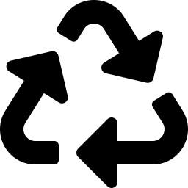
LOOP
Reusable packaging,
on autopilot.
The circular packaging layer for food delivery — cutting single-use waste without adding friction for restaurants, couriers, or diners.
Seed Round Pitch | August 2026
01

Slide 2



The Problem
Single-use food packaging is cheap for restaurants and expensive for everyone else.
8.5M tons
of single-use foodware waste generated in the U.S. every year
Diners want
sustainable options.
1 in 4
items in urban curbside litter surveys is delivery packaging
73%
$0.38
average per-order packaging cost restaurants absorb today
of delivery customers say packaging waste affects which apps and restaurants they choose.
Source: 2025 industry sustainability survey
LOOP // SEED PITCH
02

Slide 3
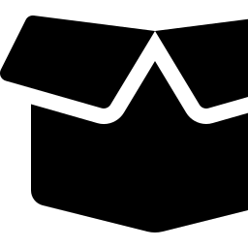

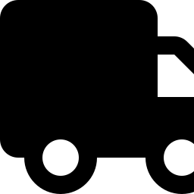

The Solution
Loop is a reusable-container network that plugs into the delivery apps and POS systems restaurants already use.
The Loop Cycle
Durable containers
1
Rated for 300+ wash cycles, restaurant-branded, stackable for storage.
Order
placed
Zero-effort returns
Diners drop bins at 12,000+ retail and transit points — no app step required.
5
2
Reverse logistics
Back to
restaurant
Delivered in
Loop box
We collect, wash, and redistribute containers through regional wash hubs.
Drop-in integration
One API connects to DoorDash, Uber Eats, Toast, and Square in under a day.
4
3
Washed &
redistributed
Dropped at
return point
LOOP // SEED PITCH
03

Slide 4

How It Works
From checkout to clean container, in four steps.
01
02
03
04
Order
Deliver
Return
Refresh
Diner selects “Loop packaging” at checkout — no new app, no extra tap.
→
Restaurant packs the order in a Loop container; courier delivers as usual.
→
Diner drops the empty container at any nearby Loop point within 14 days.
→
Loop washes, sanitizes, and returns containers to the restaurant's supply.
LOOP // SEED PITCH
04

Slide 5
Market Opportunity
A packaging category being redrawn by regulation and consumer demand.
TAM
$14.2B
Total U.S. spend on food-delivery packaging annually
SOM
$180M
SAM
$3.6B
Spend concentrated in dense urban metros where reuse loops are logistically viable
SOM
$180M
Realistic 5-year capture across 12 launch metros at current unit economics
Sources: NRDC packaging waste report; internal TAM model, 2026
LOOP // SEED PITCH
05

Slide 6

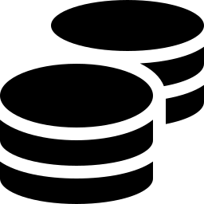
Business Model
Recurring revenue from three sides of the same network.
Restaurant Subscription
Platform Licensing
Container Sales
$0.29
Rev-share
$4.50
per order
per integration
per unit, wholesale
Flat per-order fee replaces disposable packaging spend — typically a net savings.
Delivery apps license Loop as a checkout option and share a slice of order value.
Loop-branded containers sold to restaurants running a hybrid in-house program.
LOOP // SEED PITCH
06

Slide 7
Traction
12 months post-launch in Portland and Austin.
41.5K
reuse cycles in July, up 13x since launch
94%
container return rate within 14 days
68
restaurant partners live across 2 metros
LOOP // SEED PITCH
07

Slide 8


Competitive Landscape
Reverse logistics is the moat — most players stop at selling the container.
Handles pickup &
washing
Zero setup for
restaurant
Works with any
delivery app
Cuts packaging
cost per order
Loop
In-house reusables
Compostable disposables
Deposit-return schemes
LOOP // SEED PITCH
08

Slide 9

Team
Operators who've built supply chains and consumer products at scale.
Maya Ostrowski
Devon Achebe
Priya Ramanathan
Sam Whitfield
CEO & Co-Founder
CTO & Co-Founder
Head of Partnerships
Head of Operations
Ex-Instacart ops lead; scaled last-mile logistics across 40 metros.
Built the routing engine at a top last-mile delivery startup.
Led restaurant partnerships at a national delivery platform.
Ran reverse-logistics network design for a national retailer.
Backed by advisors from Rubicon, Recycle Track Systems, and DoorDash's sustainability team.
09

Slide 10
The Ask
Raising to expand from 2 metros to 8 over the next 18 months.
$4.5M
18-Month Milestones
Launch 6 additional metro markets
Seed round, priced round on a $22M cap
Reach 500 restaurant partners
Hit 1M reuse cycles / month
Close platform deal with a top-3 delivery app
LOOP // SEED PITCH
10

Slide 11

Every reuse is one less
container in a landfill.
Let's build the reuse infrastructure delivery has been missing.
Maya Ostrowski · maya@loopreuse.com · loopreuse.com
11

