Slide 1
SRI SRI UNIVERSITY
NAME - TITAN KUMAR BEHERA. ROLL NO - FET-BCA-2024-28-034 SEM-5th
ELDP

Slide 2


Slide 3
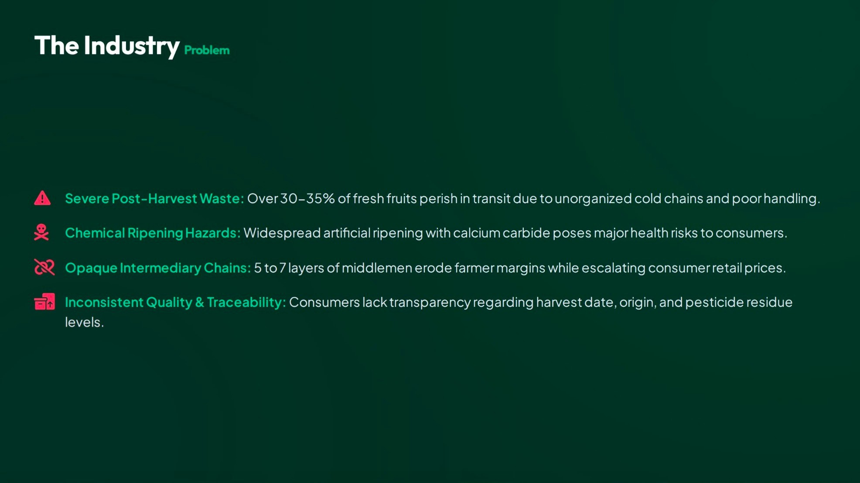

Slide 4
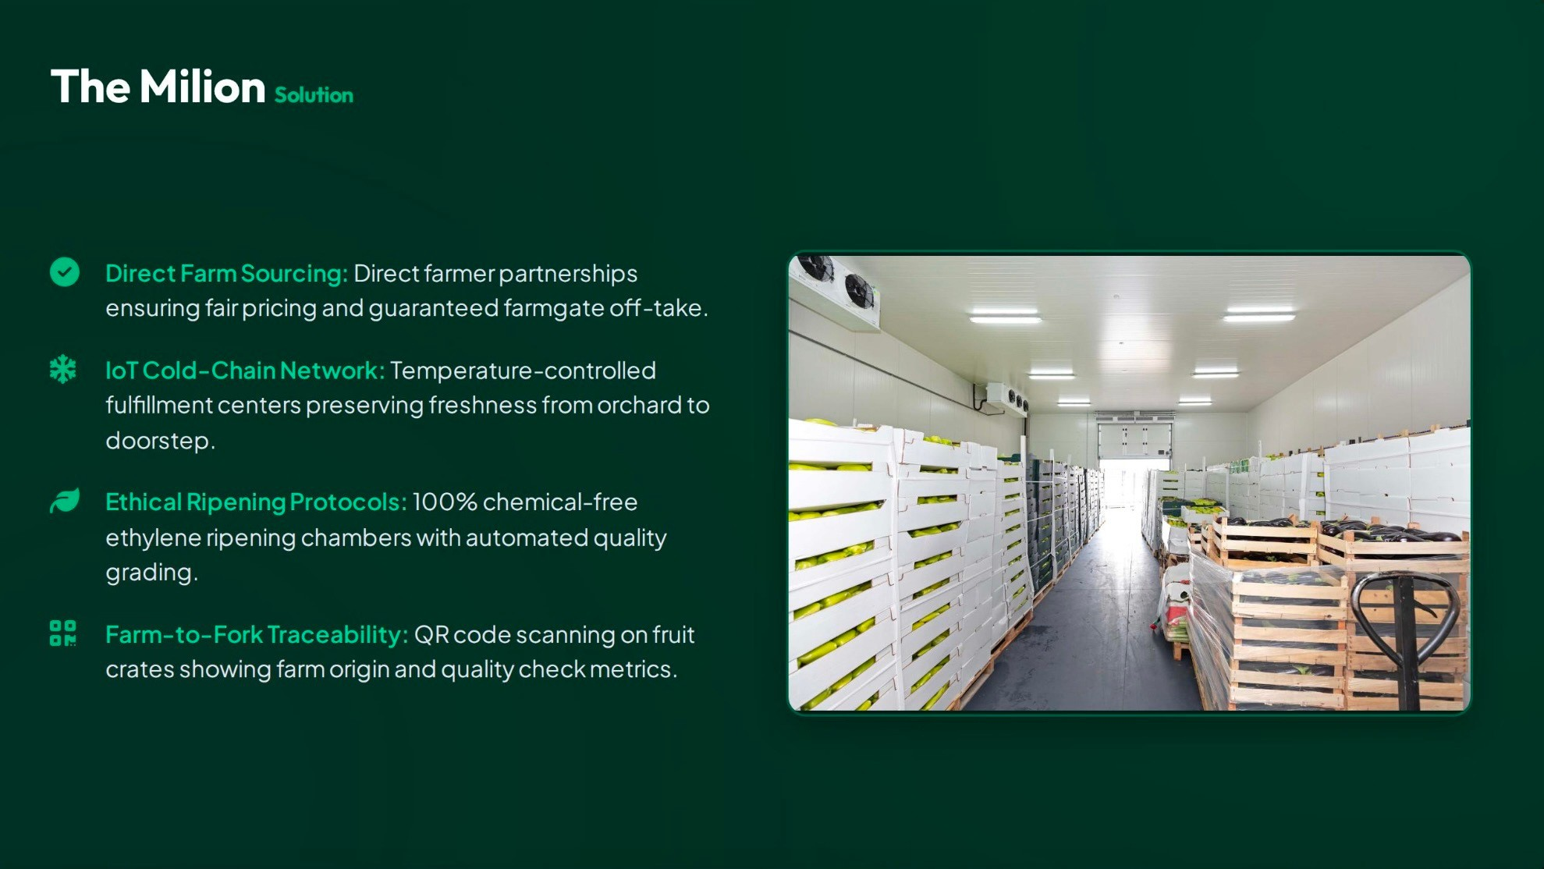

Slide 5




Slide 6


Slide 7
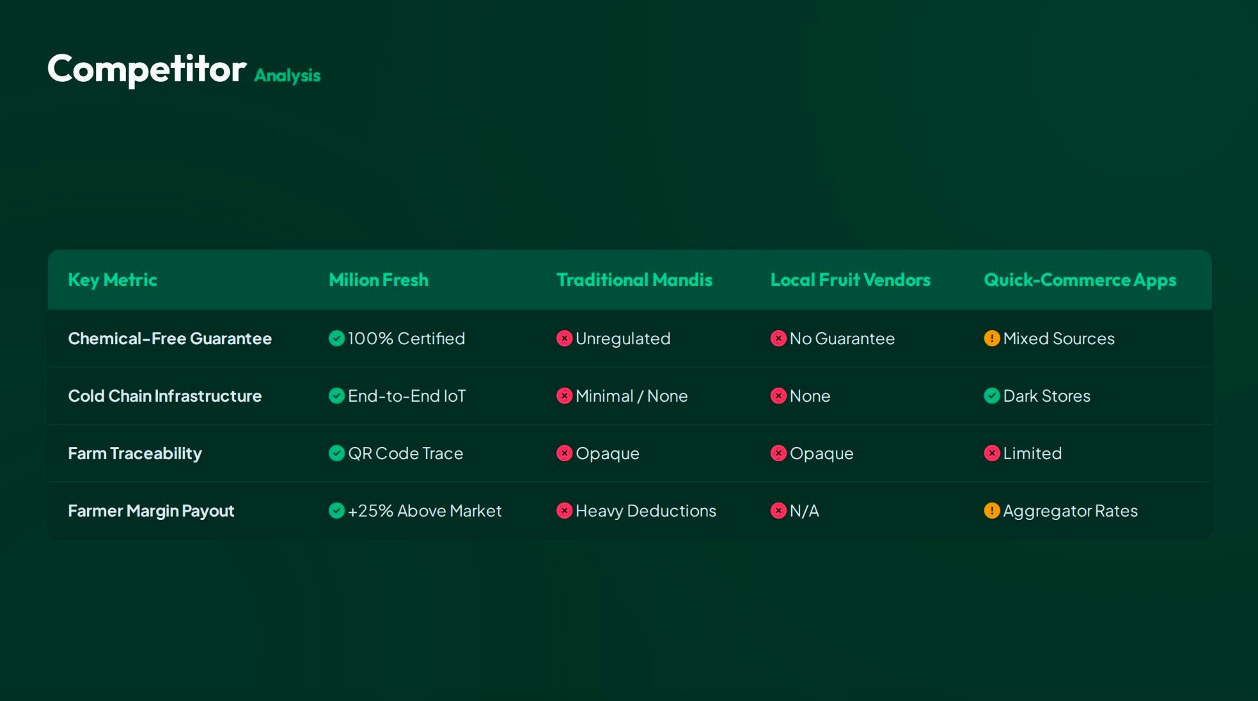

Slide 8
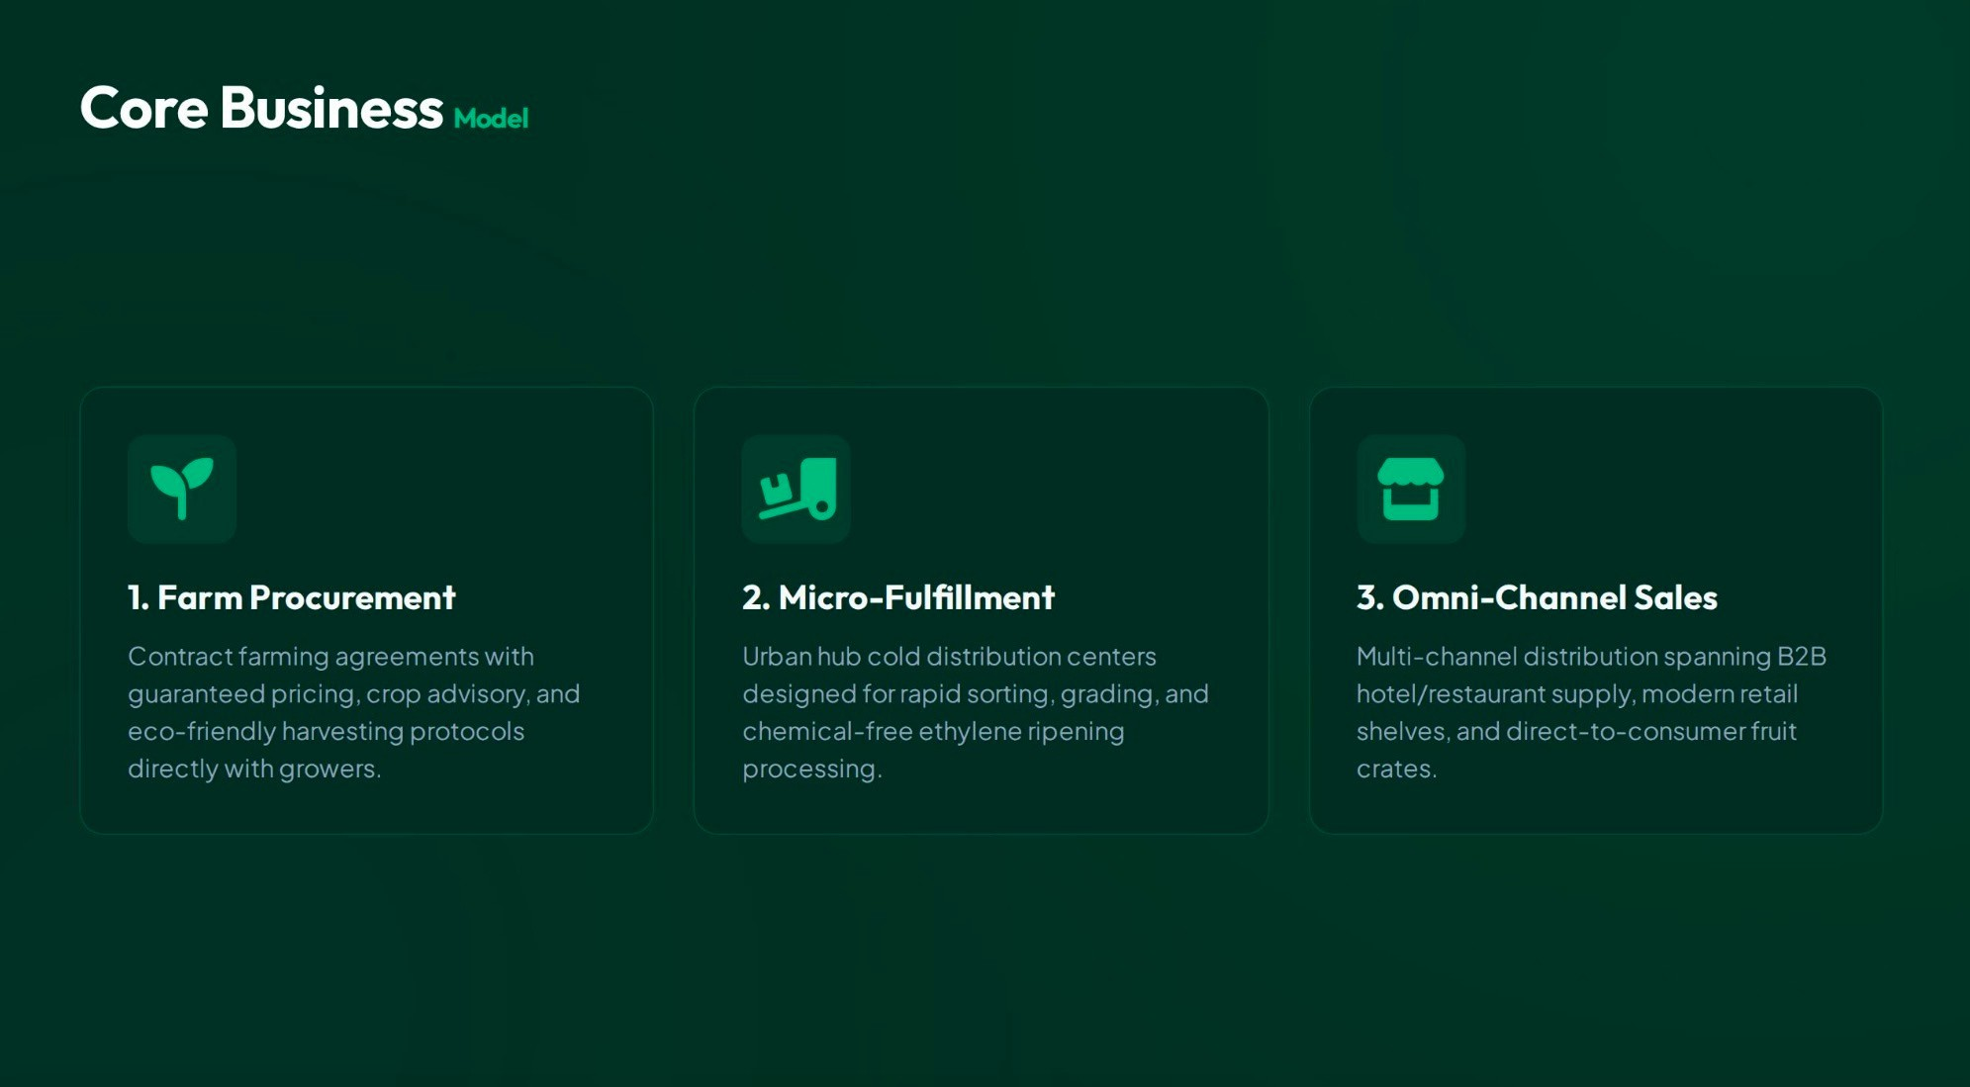

Slide 9
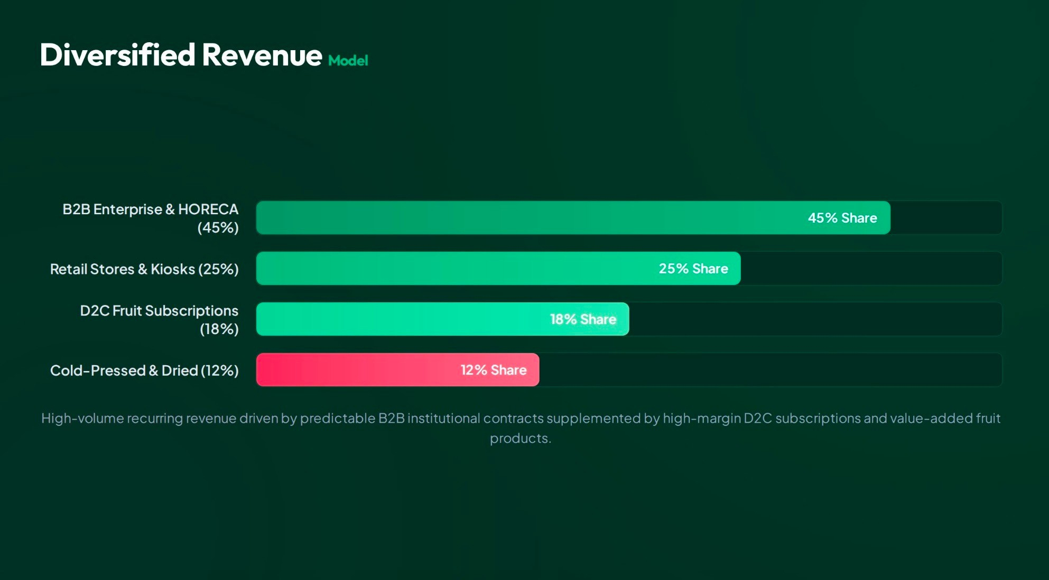

Slide 10
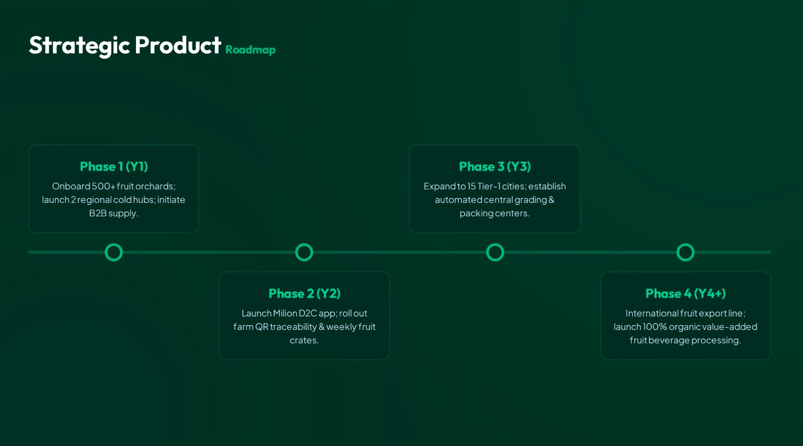

Slide 11
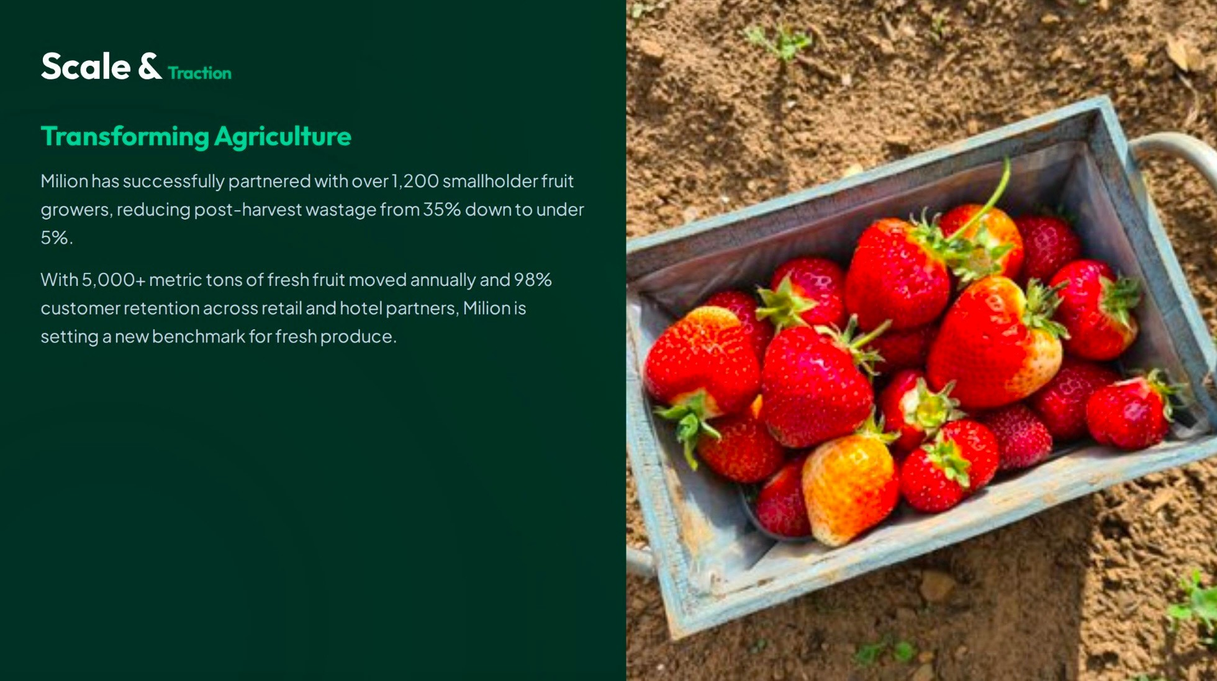

Slide 12




you

