Slide 1

Secure100 AI : The Future of App Security Scanning
Revolution security in mobile applications through intelligent technology .

Slide 2

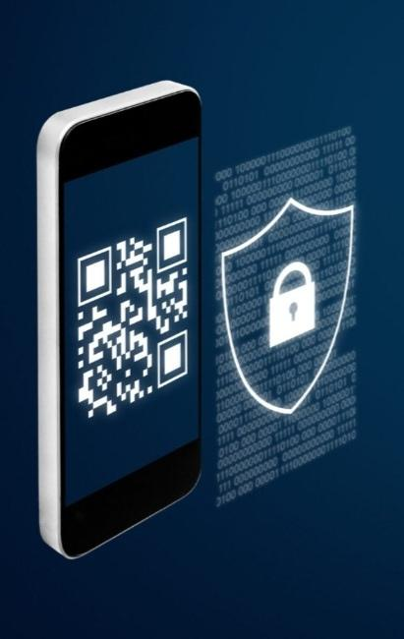
Secure100 AI
AI-powered mobile app security scanner that protects users by detecting privacy risks, unsafe permissions, and suspicious applications .
• Name:- “Secure100 AI” represents complete digital protection with AI-powered security analysis .
• AI Scanner:- Checks installed apps for malware risks, privacy issues, and suspicious behavior .
• Mobile Security:- Works with smartphones to analyze app permissions like camera, contacts, location & storage .
• Security Score:- Provides easy Safe / Medium / High Risk ratings for every app
.
• AI Assistant:- Guides users with security tips and protection steps .
• Tagline:
“Smart AI Protection for Every Smartphone”

Slide 3

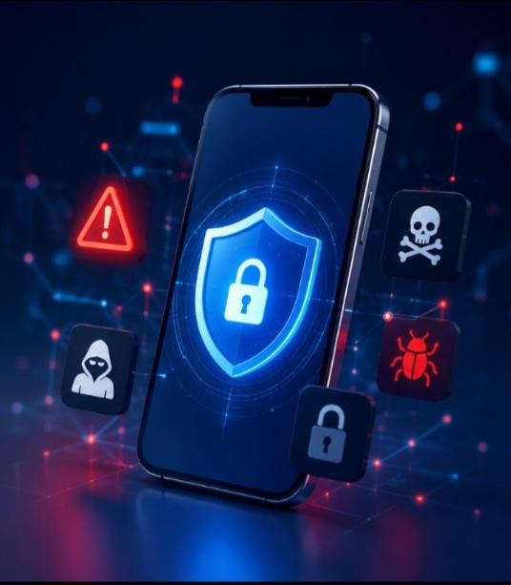
PROBLEM STATEMENT
Context Setting
Increasing mobile app threats & privacy risks .
• Millions of apps request unnecessary permissions .
• Users cannot easily identify unsafe or risky apps .
• Personal data leakage through hidden trackers .
• Difficult to understand app privacy policies .
• Malware & phishing apps are increasing .
• No simple AI-based security guidance for normal users .

Slide 4

IDEATION & VISION
Solution description at a high level
Secure100 AI is an AI-powered cybersecurity assistant that helps users protect their smartphones by scanning apps, detecting privacy risks, and giving simple security recommendations.
Example of a solution:
A user installs a new app → Secure100 AI scans the app → AI analyzes permissions, trackers, and security risks → provides a Safe / Medium / High Risk score with protection advice.
• AI-based innovative security scanner .
• Detects risky app permissions and suspicious behavior .
.• Provides instant privacy & safety reports .
• AI chatbot explains threats and solutions .
• Simple protection for non-technical users .
Value Proposition:
“Smart AI security for every smartphone user”
Innovations:
AI Risk Analysis + App Permission Scanner + Cybersecurity Assistant

Slide 5
INNOVATION
Innovations and it’s benefits
• Real-Time Security Score .
Shows every app as Safe / Medium Risk / High Risk .
• Privacy Protection Dashboard .
Helps users understand and control their digital safety .
Right side title:
1-Click App Security Scan
• One tap to scan installed applications .
• AI checks permissions, trackers & suspicious activities .
• Instant security report generation .
• User-friendly protection for everyone .
• Future-ready AI mobile security platform .

Slide 6
COMPETITION
Key Differentiators
• AI Security Assistant – Explains threats in simple language .
• 1-Click App Scan – Instantly checks installed applications .
• Smart Permission Analysis – Detects risky camera, location & data access .
• AI Risk Score – Shows Safe / Medium / High Risk rating .
• Personalized Security Tips – Suggests actions to improve protection .
• Simple Interface – Built for every smartphone user .
• Existing mobile security apps provide basic antivirus and scanning features .
• Many solutions lack AI-based risk explanation and simple privacy guidance .
• Secure100 AI focuses on intelligent, user-friendly mobile protection .
• Huge opportunity as smartphone privacy and cyber threats continue growing .

Slide 7
VALUE PROPOSITION
Value Secure100 AI will bring .
• A smart way to protect smartphone users from digital threats .
• Helps users understand app safety before trusting applications.
• Uses AI technology to make cybersecurity simple and accessible .
• Provides fast scanning, privacy insights, and security recommendations .
• Builds user confidence by protecting personal data .
Target Customers:
Smartphone users, students, professionals, and businesses concerned about mobile privacy .
Operating Principles
• AI-powered app security scanning .
• Fast & accurate risk detection .
• User-friendly security experience .
• Privacy-focused data protection .
• Real-time threat analysis .
• Simple Safe / Medium / High risk reports .
• Continuous AI security improvement .

Slide 8
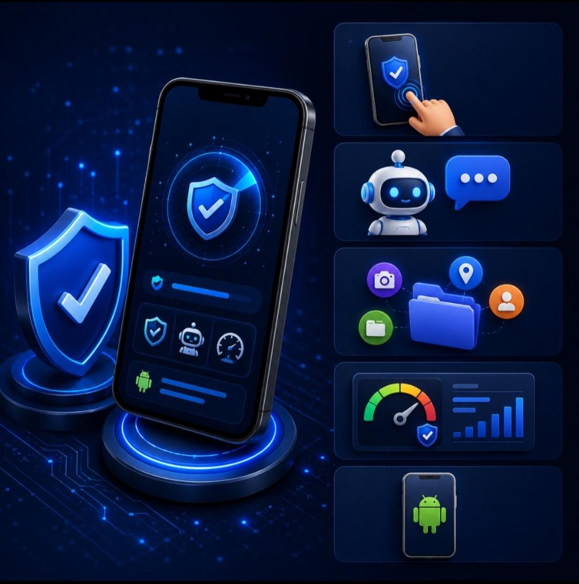
MVP - APPS
Secure100 AI App
• One-tap mobile app scanning feature .
• AI chatbot for cybersecurity guidance .
• Permission analysis ( Location, Contacts, Storage) .
• Security dashboard with risk score .
• 1-Click App Security Scan is the main objective of Secure100 AI .
• Users can scan installed applications and detect security risks instantly .
• App shows AI-generated safety reports with Safe / Medium / High Risk status .
• Users get details about risky permissions, trackers, and privacy issues .
• Built using FlutterFlow with Firebase database and AI integration .

Slide 9
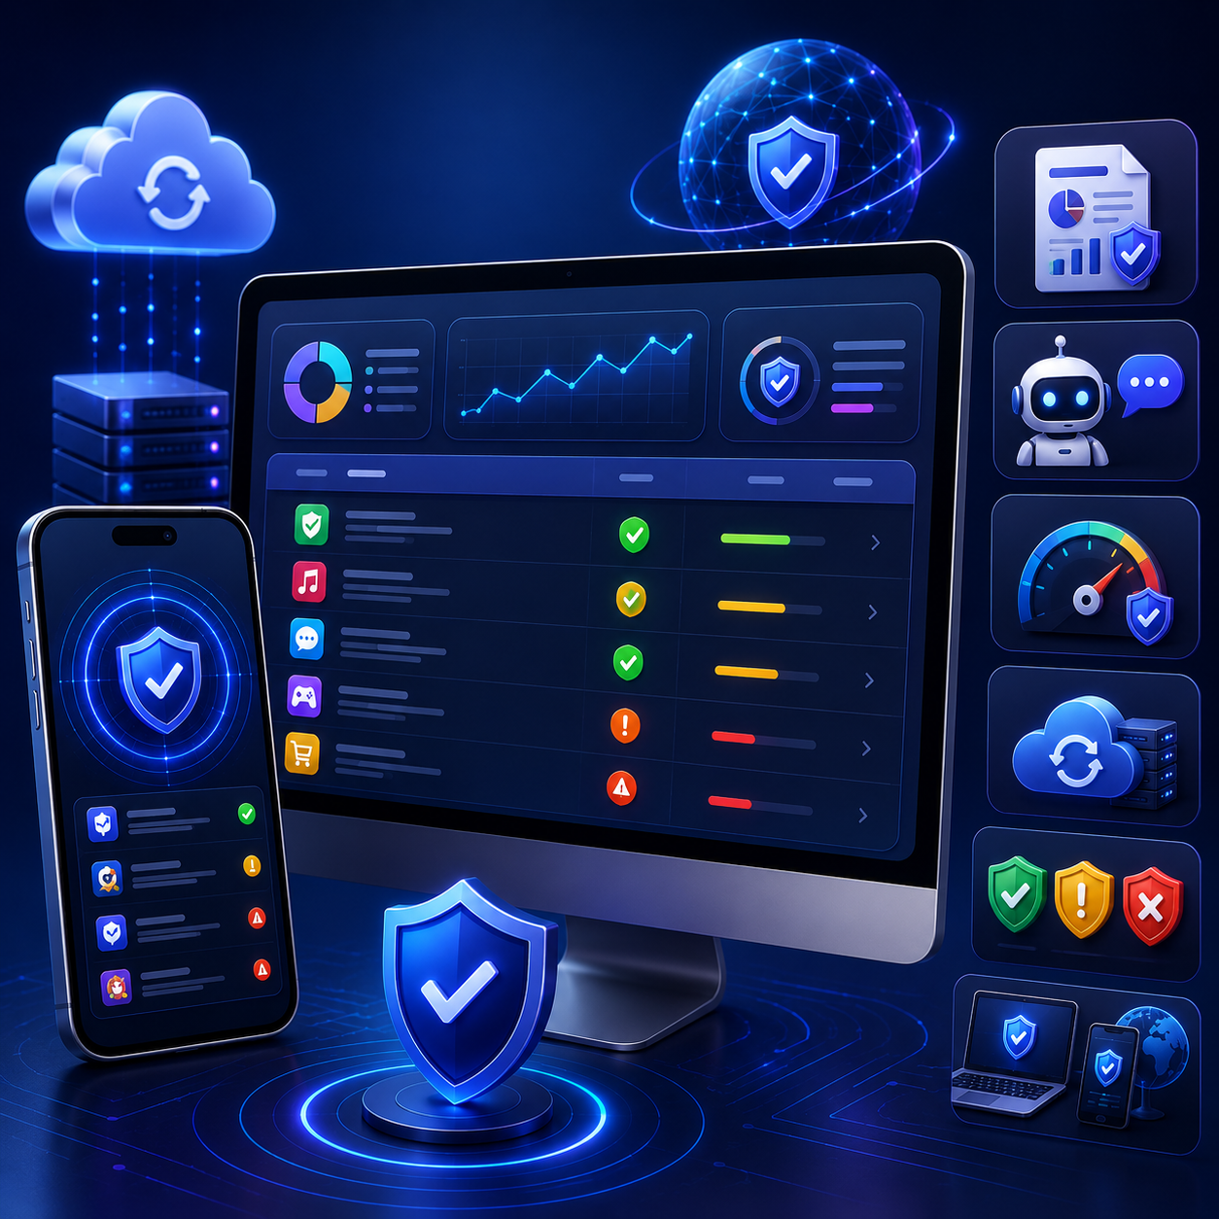
MVP - REAL TIME DATA SHARING
Secure100AI.com
• View app scan history & security reports .
• Personalized AI cybersecurity recommendations .
• Real-time risk score synchronization .
• Cloud-based security intelligence updates .
• Dashboard showing Safe / Medium / High Risk apps .
• Future support for web + mobile security management .
• Real-time app security analysis & data updates .
• User history and scan reports accessible anytime .
• Firebase stores user profiles, scan results & risk information securely .
• AI continuously analyzes new threats and improves detection .
• Instant alerts when suspicious app behavior is found .
• Smart connection between mobile app, AI model, and security database .

Slide 10
IDEATION - USE CASES
Use-Cases
• New App Installation Check
– Scan apps before trusting them .
• Privacy Protection
– Detect apps accessing camera, contacts, location & storage .
• Risky App Detection
– Identify suspicious permissions and security threats .
• AI Security Guidance
– Chatbot explains problems and gives safety steps .
• Use cases where Secure100 AI service will be useful .
• Each use case focuses on different smartphone users and security needs .
• Provides extra protection compared to traditional security apps .
• Helps users make safer decisions before using applications .

Slide 11
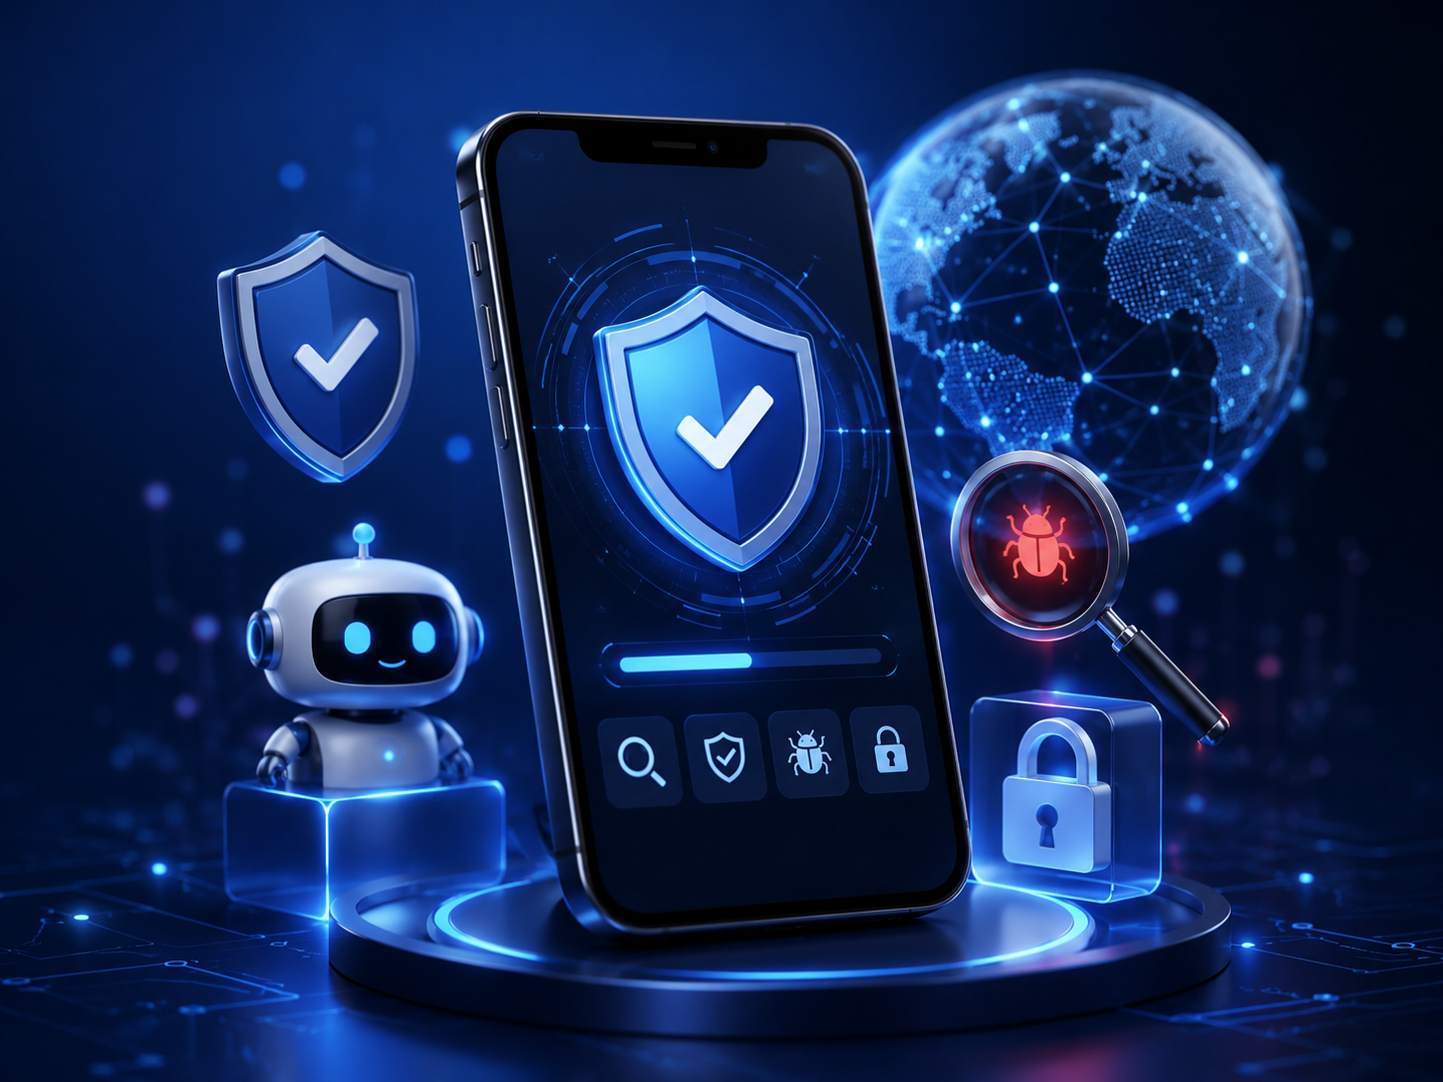
TAM , GTM AND SCALE
• Secure100 AI targets the growing smartphone security and privacy protection market.
• Start with Android users who need simple AI-based app safety checking .
• Expand by adding advanced AI threat detection and more security features.
• Grow through Play Store launch, cybersecurity awareness, and partnerships .
• Future expansion: personal users → businesses → enterprise security solutions .

Slide 12
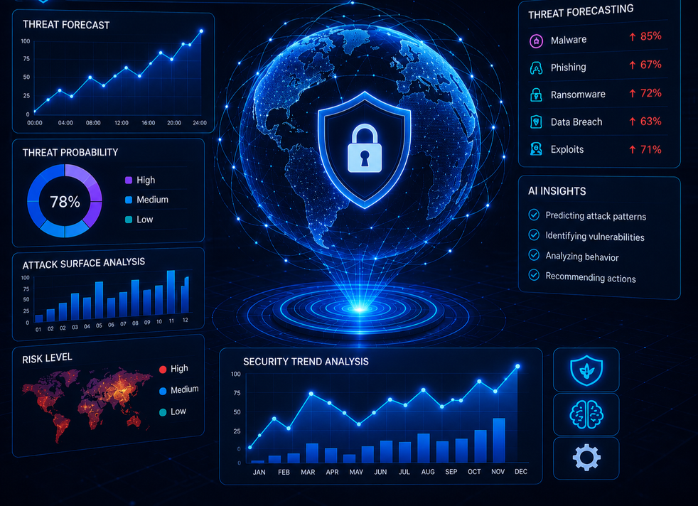
SCM & FLEET PLANNING
• Use AI technology to manage security scanning services and improve user protection .
• Optimize threat detection system to reduce security risks for users .
• Provide better coverage against malware, privacy issues, and unsafe apps .
• Minimize impact of new cyber threats through continuous AI updates .
AI Security Forecasting
• AI analyzes app behavior and predicts potential threats .
• Uses cloud security intelligence for faster protection .
• Provides instant alerts and safety recommendations .
• Improves scanning accuracy with updated threat data .

Slide 13

GTM & SERVICE PORTFOLIO
• Identification and analysis of target users who need mobile app security protection .
• Plan GTM strategies to reach smartphone users, students, professionals, and businesses .
• Build trust through AI-powered privacy protection and simple cybersecurity solutions .
• Provide different security services according to user needs .

Slide 14
TAM , SAM , SOM
Potential Outcomes
Best-Case Scenario
• Becomes a leading AI-powered mobile security platform .
• Millions of users trust Secure100 AI for app safety .
Realistic Success Scenario
• Gains active users through Play Store launch .
• Generates revenue through premium AI security features .
Initial Growth Scenario
• Starts with Android app security scanning .
• Improves AI detection using user feedback .
• Grows from individual users to business security solutions.
* TAM, SAM & SOM analysis helps identify the market opportunity for AI mobile security solutions.
* Shows the journey from global cybersecurity users to initial target coustomers.
  Helps Secure100 AI plan realistic growth from startup stage to global security platform .

Slide 15
PRICING & REVENUE MODEL
• List of factors that influence Secure100 AI’s revenue and cost structure .
• Secure100 AI gains advantage through AI-powered security innovation .
• Affordable cybersecurity solution for every smartphone user .
• Multiple revenue channels through premium security services .
Revenue Sources :-
• Free basic app scanning .
• Premium AI protection subscription .
• Business security plans .
• Advanced privacy reports & features .
Future Optimizations
• Improve AI threat detection accuracy .
• Add advanced malware & privacy scanning .
• Faster real-time app analysis .
• AI chatbot with personalized security guidance .
• Enterprise security dashboard for companies .
• Cloud-based automatic security updates .

Slide 16
Sales Pitch & GTM
• Secure100 AI provides smart AI-powered mobile app security protection
• One-click scanning to detect risky apps, permissions, and privacy threats
• Simple security solution for students, professionals, and businesses
• Builds user trust with AI risk scores and safety recommendations
---
SALES PITCH & GTM
Marketing Ideas
*Launch Secure100 AI on Google Play Store .
*Promote through cybersecurity communities & social media .
*Provide free app scanning to attract users .
*Premium AI protection subscription model .
*Partner with tech creators and security platforms .
*Secure100 AI provides smart AI-powered mobile app security protection .
* One-click scanning to detect risky apps, permissions, and privacy threats .
* Simple security solution for students, professionals, and businesses .
* Builds user trust with AI risk scores and safety recommendations .

Slide 17

GROWTH POTENTIAL
* AI cybersecurity technology can protect millions of smartphone users .
*Increasing mobile threats create demand for security solutions .
*Expand features using AI innovation and cloud security .
*Opportunity to enter personal and business security markets .

Slide 18
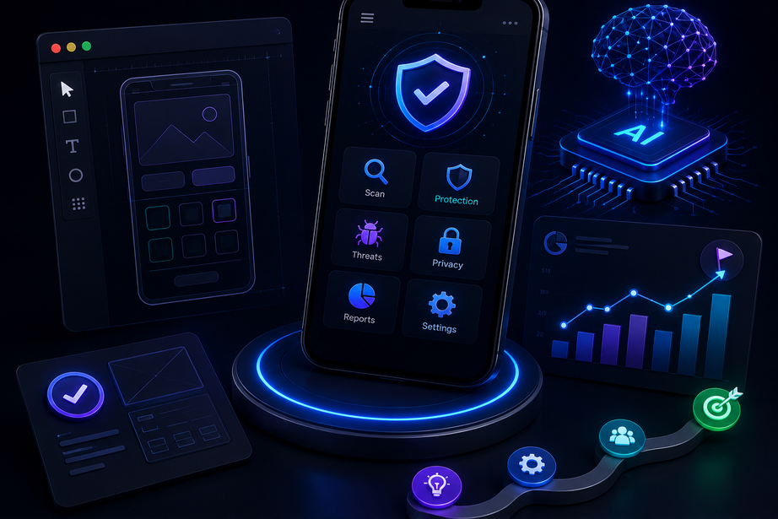
PROGRESS SO FAR
• Secure100 AI concept and business model created .
• FlutterFlow mobile app prototype developed .
• Firebase database integration planned .
• AI chatbot/security assistant feature designed .
• App security scanner workflow completed .
Progress To Date
* App UI/UX design completed .
* Core features identified .
*AI scanning system planned .
* Pitch deck and startup roadmap prepared .

Slide 19
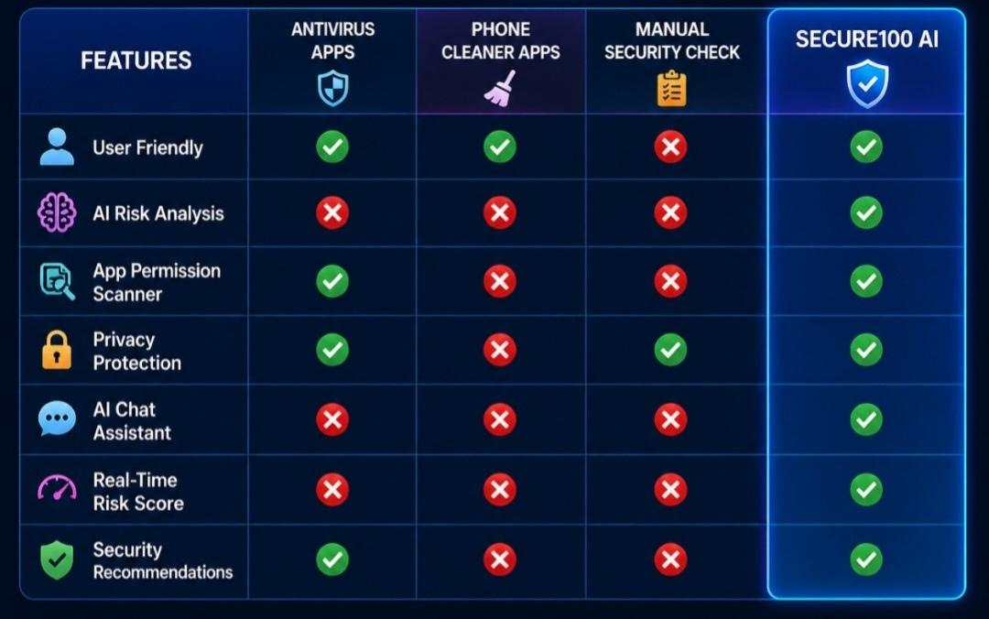
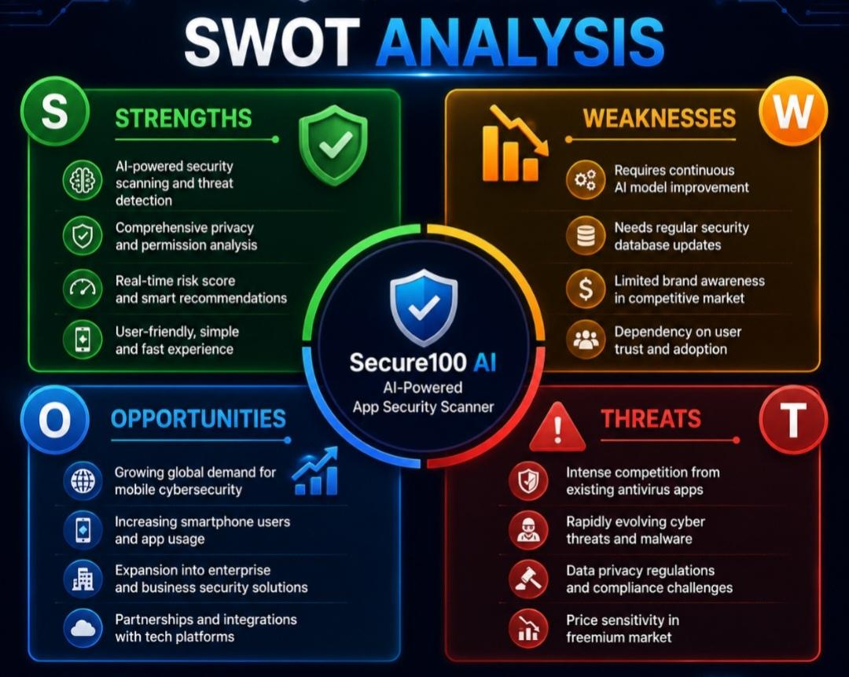
COMPETITIVE ANALYSIS

Slide 20
BE INSPIRED TO WIN! THANK YOU!

