Slide 1
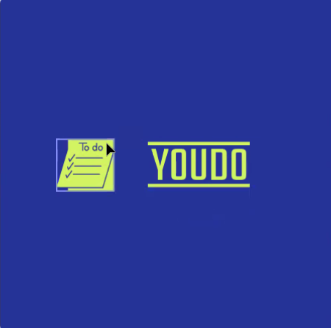
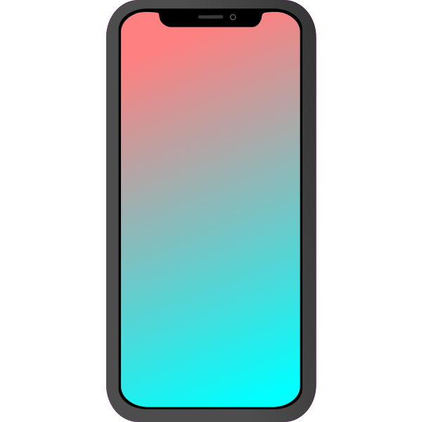
To do
List
App
Dream To-do list
To-do list app
Do to Dream Big

Slide 2
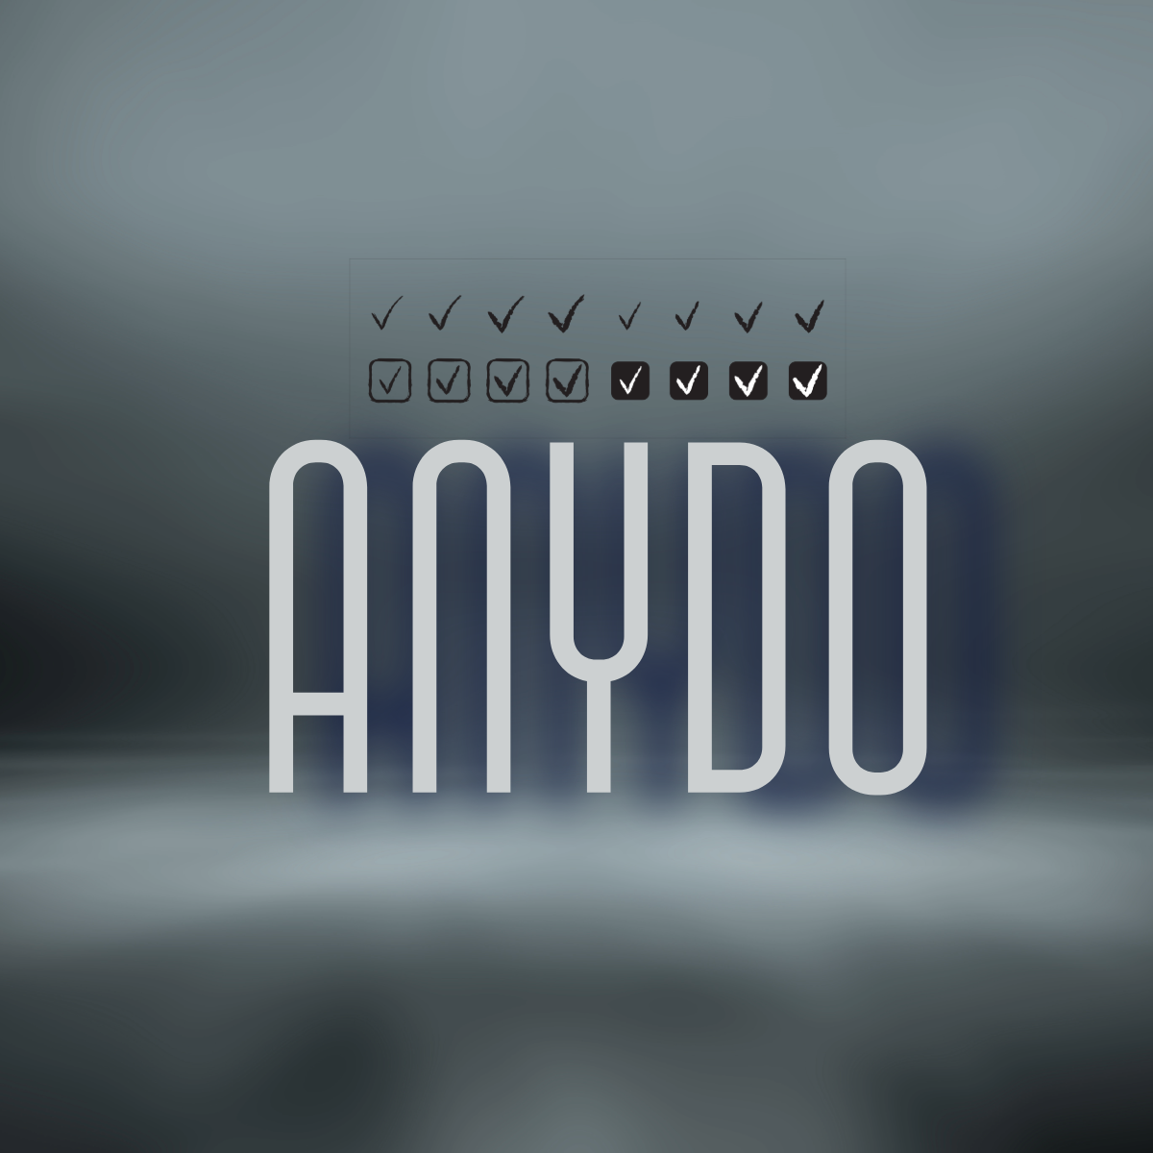

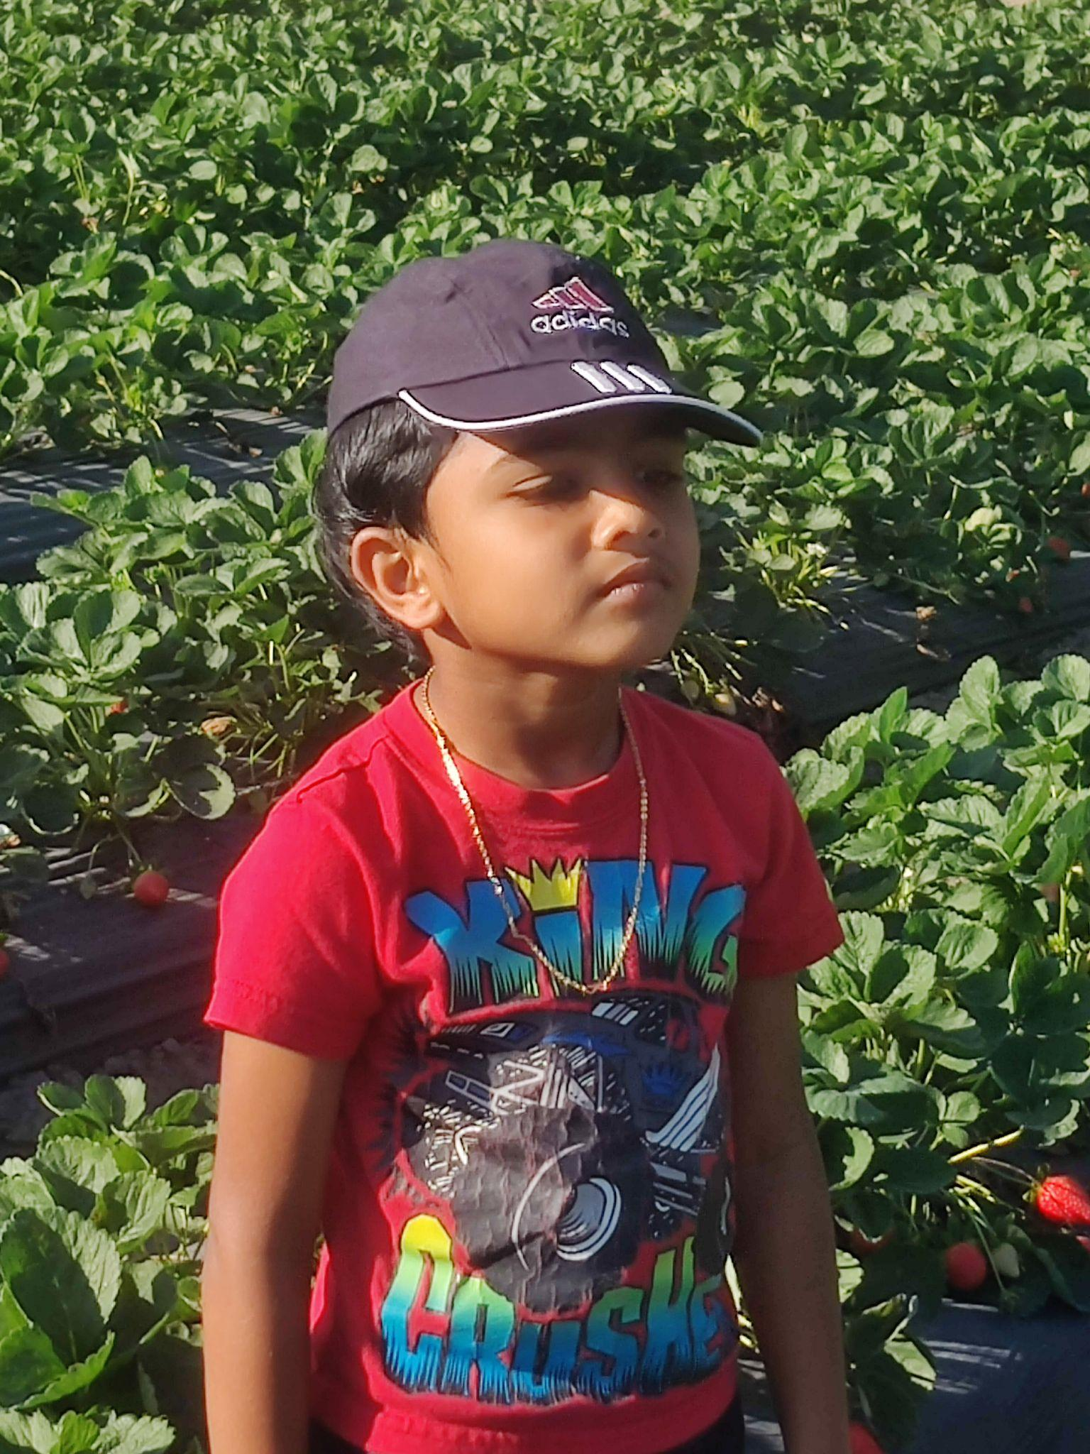


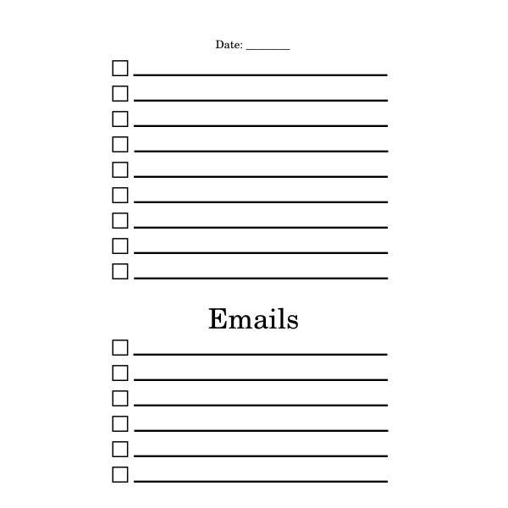

YOUR LOGO
OUR TEAM
Team Member’s Name & Role
Team Member’s Name & Role
Team Member’s Name & Role
Name: Tanav
Role:Manager
Name:Ronish
Role: Co-Founder
Name: Tarun
Role: Founder
Name: Kingston
Role:CEO(Chief Executive Officer)

Slide 3

YOUR LOGO
Problems & Existing Alternatives
Too simple, needs more details.! | AI generated images.
We could use more AI generated stuff like moonprenuer does! | AI generated images are AI generated
Since its too simple we also need more animations and we need stronger AI. | AI generated images lack skill

Slide 4
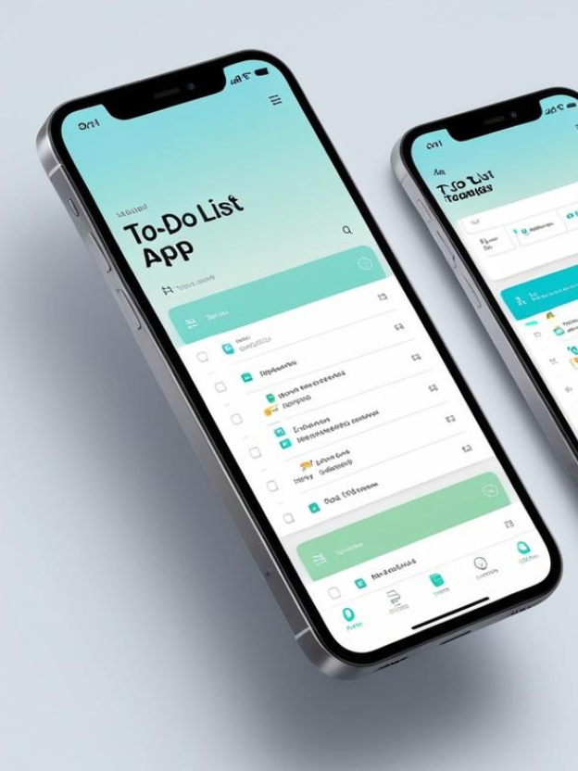
YOUR LOGO
IDEA
The idea is to make a To-Do List app and make it as reminders to do their chores and finish stuff they need to.

Slide 5
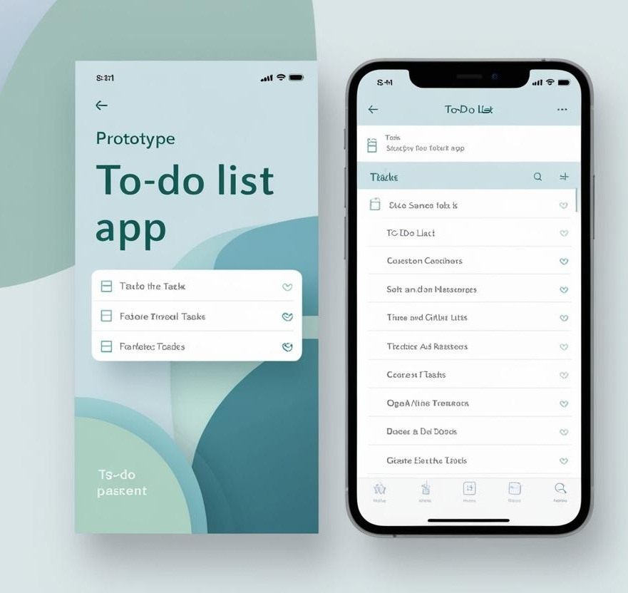
YOUR LOGO
Solution
The solution is to make a To-Do List app and make reminders to do chores and help organize your day and do work.

Slide 6



YOUR LOGO
Design & Innovation
Colorful Colors
Key Metric 2
Key Metric 3
.
We have AI to help you schedule your tasks.
It takes only a few clicks to schedule your entire day!.

Slide 7

















YOUR LOGO
PRODUCT DEVELOPMENT ROADMAP
Improvement & Refinement
Ideation
Market Research
we use the Main Product to improve another prototype of our product
We can make money while spending alot to improve the app
Iterate based on feedback from product testing results.
2024. Sept
2025. Jan.
2025. MAR
Product Design
WE ARE HERE
Testing & Prototyping
Launch
It will be colorful and be easy to navigate through the app
We then will launch the app on the App Store for everybody to use and enjoy.
We are prototyping the app to see any loopholes or errors inside the app
2024. Dec
2025. Feb.
2025 APR

Slide 8

YOUR LOGO
The Unique Value Proposition.
Our App is unique from most todo list apps because it has a Generative AI that lets you schedule your entire day in seconds!

Slide 9



YOUR LOGO
Strengths | Weaknesses | Opportunities | Threats
Our app has the best Ai available unlike the other apps which use weaker Ai. Our company’s strongest asset is its AI and also its cheaply priced. | If you lose your phone you won’t be able to use the app but you can download the app on another device. The area of which our to-do list app needs strengthening is its functionality since its memory space is limited to a computer memories card | Better AI Better UI | Monday.com is a big competitor Are there companies that could potentially become competitors?
HABITIKA
Todoist

Slide 10
YOUR LOGO
Competitive Edge 1
Competitive Analysis
We have an AI scheduler that helps you schedule new things depending on your current schedule.
Competitive
Edge 2
Competitive
Edge 3
Our app is simpler and is easier to set up than most competitors
it only takes a few clicks to schedule your day!
it

Slide 11
YOUR LOGO
MARKET OPPORTUNITY
TAM
SOM
Online on the app store so
our app is a Total Addressable
market.
Our “SOM” (Servicable Obtainable Market) is that you can Obtain our market by downloading it on the app store and on our site or and site where you can download
SAM
You can find our SAM on the app store and on our site on google or microsoft where you can download our app

Slide 12
YOUR LOGO
Marketing Channels
Marketing Channel 1 | Marketing Channel 2 | Marketing Channel 3
We will use advertisements to attract customers. | we will also use social media to advertise our app to others. | Also, we will ask other customers to advertise our app on social media.

Slide 13

YOUR LOGO
223 DOLLARS
200$
Cost Structure and Revenue Stream
100$
it takes 222 USD to put our app on the app store for 2 years and put it on google play.
20$
10$
if we started with 500$ (USD) then we would have 277$ left, which would allow us to help improve other stuff on the website with the remaining money
0$

Slide 14
YOUR LOGO
Cost Structure and Revenue Stream
Income Statement | Q1 | Q2 | Q3 | Q4
Revenue Add the product of your average sales price and the number of units sold with your other sources of revenue | $ 000
Fixed Costs Add your fixed costs, such as salaries, insurance, and rent, among others | $ 000
Variable Costs Add your variable costs, such as materials, labor, and insurance, among others | $ 000
Total Costs Add your fixed and variable costs | $ 222
Profit Deduct the total costs from your total revenue | $ 000
7200$ Annually
99$ Annually
198$
223$
2$ every month per person

Slide 15
YOUR LOGO
Consumer Feedback
Person 1
Person 2
Person 3
My life will be so much better because everything will be organized with the help of this app
Now that when i will use to-do list app i always have the right amount of time for each thing and never fall behind schedule!
Its a great a idea as it will only take me a few clicks to organize my whole day and i have so much free time nowadays!

Slide 16
YOUR LOGO
THE PRODUCT UNBOXING or PACKAGING
Download the app.
Login or sign up.
Find the home screen.
Go to the make schedule to make your schedule.
Click the “done” button to finish your schedule.
The schedule will automatically remind you for what you need to do.
Once you’re done making your schedule you can click the AI button to put AI into your schedule
The AI will automatically give you the abilities to use AI in your schedule.

