Slide 1
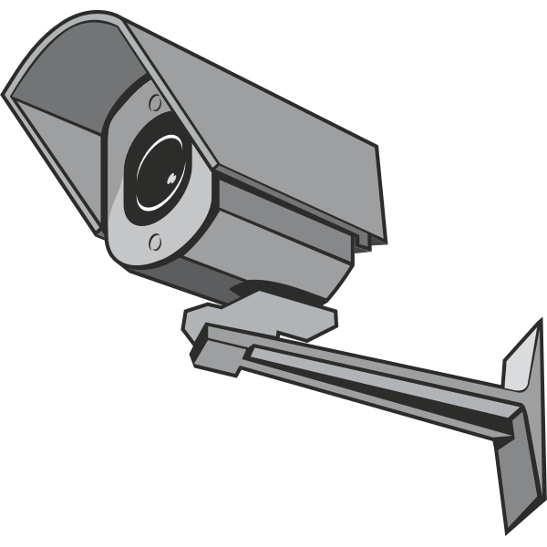
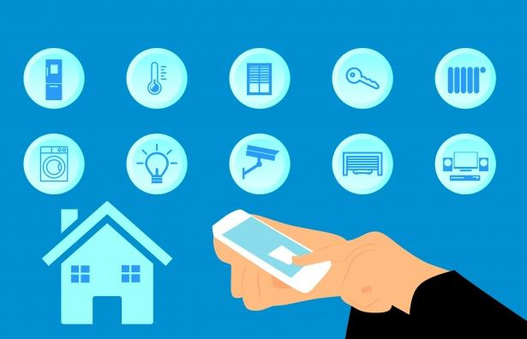
HAARV
Home security system
Stay safe with HAARV!

Slide 2
HAARV
OUR TEAM
TEAM MEMBER’s PICTURE
TEAM MEMBER’s PICTURE
TEAM MEMBER’s PICTURE
TEAM MEMBER’s PICTURE
Vikram
Hans
Aarohi
Ansh
Ronan

Slide 3
Problems & Existing Alternatives
Many people get robbed and we want to help them stay safe. | People ignore this and buy cheap security systems that have bad quality and get robbed again.
People believe that any security system would be fine to keep them safe and waste money, but we want them to have the best quality security system. | People keep on wasting money thinking that the next security system they will have should be good enough.
Robbers can easily get past the security system, but our system is foolproof. | People try enforcing the security system by their own.

Slide 4
IDEA
We have come up with the idea of the security system HAARV. This security system ensures people to stay safe. We also give good pricing and deals, with the quality our customer needs. This idea has been approved by people and many people like it.

Slide 5
Solution
This Home security system app has security cameras that don’t miss any footage and cannot get hacked into. Our sensors instantly give you an update whenever something goes by. Many people have approved of this and you can test it out too.

Slide 6
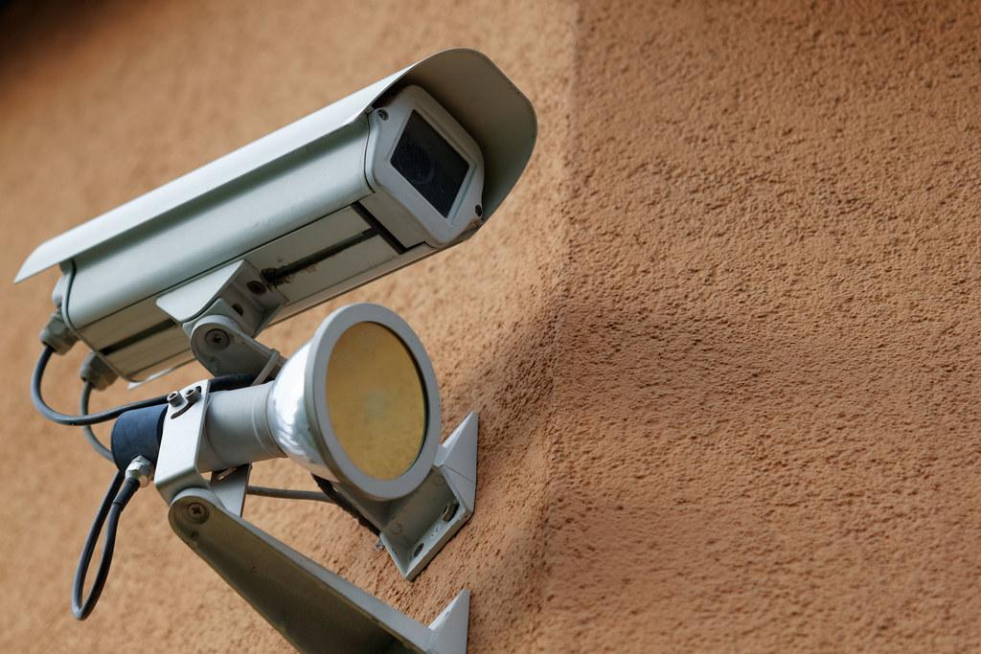
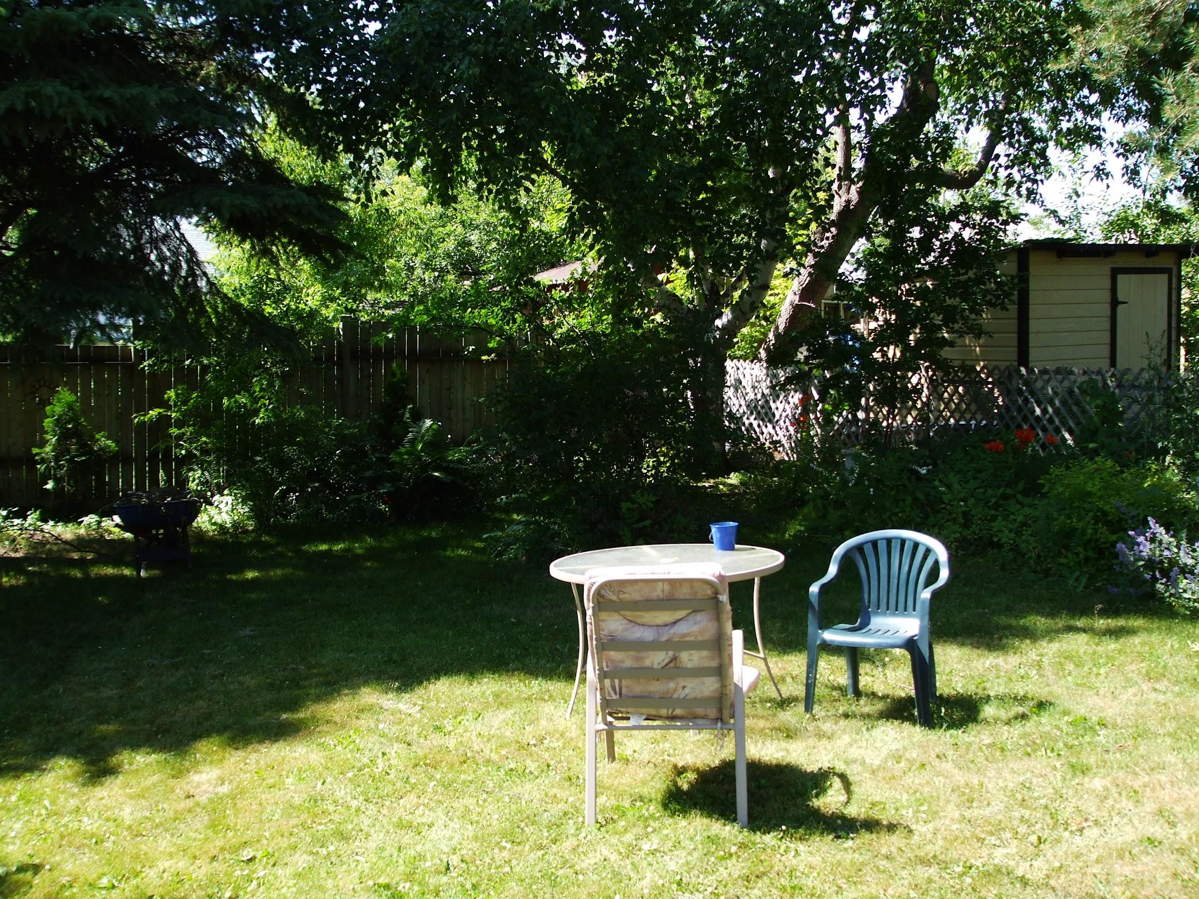
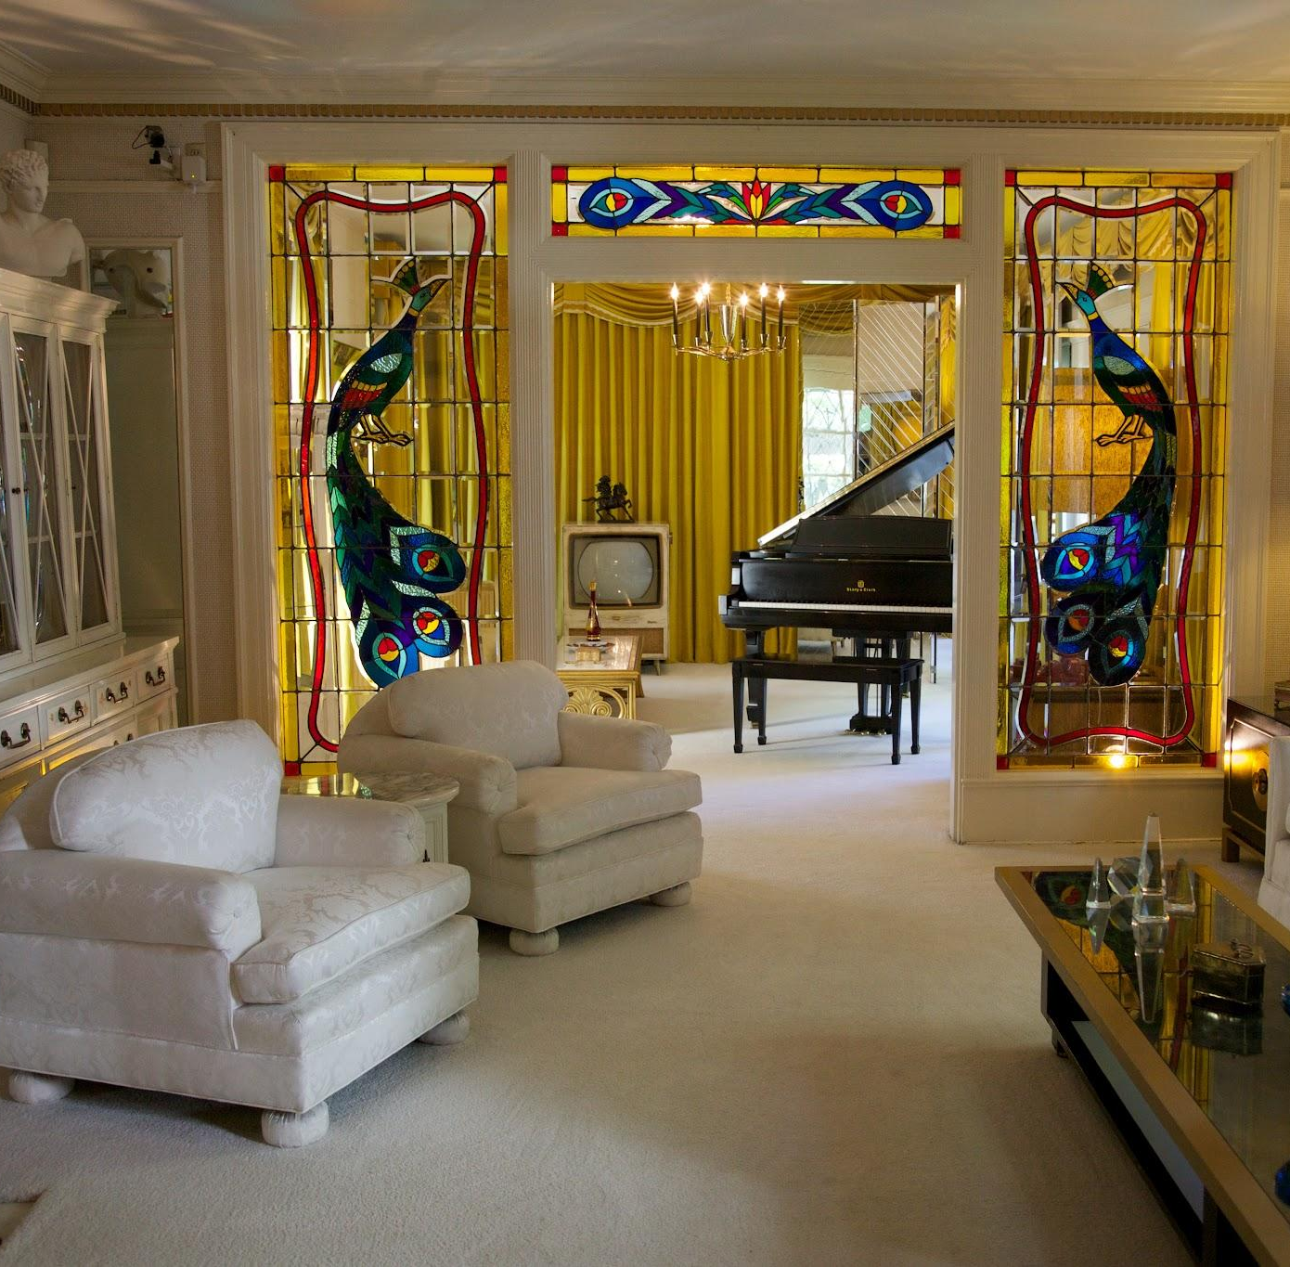
Design & Innovation
Key Metrics
Cameras:
Frontyard:
Backyard:
We feel like we will be at least 70% successful with our business idea.
Inside:
Frontyard & Inside

Slide 7
HOW IT HELPS by solving people’s problem.
Budget
Friendly
Good Quality
Easy to use
Approved by customers

Slide 8
PRODUCT DEVELOPMENT ROADMAP
October 2024
Feburary 2025
December 2024
Improvement & Refinement
Ideation
Market Research
We realized that people needed more safety so we decided to make a home security system.
We looked through the market to find trends and needs of people.
We changed certain features in our app, according to the advice given.
Product Design
Testing & Prototyping
Launch
We came up with the design of the home security system app.
We are planning to launch the product in the market with an integrated marketing strategy.
We made our first prototype and tested it out.
November 2024
April 2025
January 2025
Notes:
Phase 1: Research & Planning (September – December 2024)
September 2024: Market Analysis & Concept Validation
Market Research:
Conduct in-depth market analysis for Texas, Edison, and Hannover, focusing on consumer needs, competitor landscape, and pricing strategies.
Validate market assumptions using surveys, focus groups, and interviews.
Customer Journey Mapping:
Map out the end-to-end customer journey, identifying pain points and key decision-making moments.
Feature Prioritization:
Finalize core features like AI-driven security alerts, biometric authentication, remote monitoring, and smart home integration.
Identify differentiators such as pet detection, vacation mode, and community security sharing.
October 2024: Technical Feasibility & Product Design
Technical Feasibility Study:
Evaluate technical requirements for AI algorithms, cloud storage, and mobile app development.
Identify hardware requirements (e.g., cameras, sensors) and integration with third-party devices (e.g., Alexa, Google Home).
UX/UI Design:
Develop wireframes and prototypes for the mobile app, focusing on user-centric design and seamless navigation.
Conduct user testing sessions to gather feedback on app usability and design aesthetics.
Partnerships & Vendor Selection:
Identify and establish partnerships with hardware vendors, AI service providers, and cloud storage partners.
Negotiate contracts for hardware components, manufacturing, and distribution logistics.
November 2024: Prototyping & MVP Development
Prototype Development:
Build functional prototypes of key components, including security cameras, motion sensors, and the mobile app.
Integrate core features such as live video streaming, remote alerts, and smart lock control.
MVP (Minimum Viable Product) Planning:
Prioritize features for the MVP to validate product-market fit.
Plan for rapid iterations based on early user feedback.
December 2024: Testing & Feedback Loop
Alpha Testing:
Conduct internal alpha testing to identify and resolve major bugs and performance issues.
Test integrations with smart home devices, voice assistants, and cloud platforms.
Beta Testing & User Feedback:
Launch a closed beta program with select users in Texas, Edison, and Hannover.
Collect feedback on usability, performance, and user experience.
Implement feedback-driven iterations and enhancements.
Phase 2: Development & Prototyping (January – April 2025)
January 2025: Full-Scale Development
App Development:
Finalize app architecture, including real-time alerts, live video streaming, and remote control functionalities.
Implement AI algorithms for facial recognition, pet detection, and behavioral analysis.
Hardware Integration:
Integrate hardware components with the application, ensuring seamless connectivity and synchronization.
Test hardware compatibility with third-party devices and smart home ecosystems.
February 2025: Advanced Features & Security Protocols
Advanced Features:
Implement biometric authentication (e.g., fingerprint and voice recognition).
Integrate emergency response systems with local law enforcement and fire departments.
Data Security & Compliance:
Implement end-to-end encryption and robust data privacy measures.
Ensure compliance with GDPR, CCPA, and other relevant data protection regulations.
March 2025: System Testing & QA
Comprehensive Testing:
Conduct extensive testing, including functionality, performance, security, and usability tests.
Perform stress testing to evaluate system scalability and reliability under heavy usage.
Bug Fixing & Optimization:
Resolve identified issues, optimize system performance, and fine-tune the user experience.
April 2025: Final Preparations & Launch Readiness
Final Touches:
Finalize product design, branding, and packaging for the home security devices.
Prepare product documentation, user guides, and installation manuals.
Launch Strategy:
Develop a comprehensive launch strategy, including marketing campaigns, influencer partnerships, and PR outreach.
Plan launch events and promotional activities in Texas, Edison, and Hannover.
Phase 3: Launch & Growth (May – August 2025)
May 2025: Product Launch in Texas & Edison
Go-Live in Texas and Edison:
Officially launch the product in Texas and Edison with digital marketing campaigns, local events, and community partnerships.
Promote through social media ads, influencer collaborations, and targeted email campaigns.
Customer Support & Onboarding:
Establish dedicated customer support channels for product inquiries, installation assistance, and troubleshooting.
Provide video tutorials and live onboarding sessions for users.
June 2025: Launch in Hannover, Germany
Localized Launch Strategy:
Adapt marketing messages to resonate with the German market.
Collaborate with local influencers and tech bloggers for product endorsements.
Feedback Collection & Improvement:
Collect user feedback, monitor customer satisfaction, and resolve early issues.
Roll out software updates and firmware patches based on feedback.
July 2025: Expansion & Marketing Campaigns
Scaling Operations:
Expand distribution channels through retail partnerships and e-commerce platforms.
Increase inventory and logistics capacity to meet growing demand.
Growth Marketing:
Launch referral programs, loyalty incentives, and bundle offers to boost customer acquisition.
Implement seasonal campaigns for summer vacations and back-to-school security needs.
August 2025: Customer Engagement & Retention
Customer Experience Enhancement:
Launch advanced features like community security sharing and personalized security insights.
Introduce subscription-based services for cloud storage and 24/7 monitoring.
Retention Strategies:
Implement customer retention programs, loyalty rewards, and user communities.
Launch regular software updates to enhance the user experience.
Phase 4: Optimization & Expansion (September – December 2025)
September 2025: Data Analysis & Product Optimization
Data Analytics:
Analyze user behavior, feature usage, and customer feedback to identify areas for improvement.
Implement data-driven enhancements to the application and hardware.
Product Iteration:
Optimize AI algorithms for more accurate threat detection and reduce false alarms.
Introduce new features based on user requests and competitive analysis.
October – December 2025: New Markets & Product Lines
Geographical Expansion:
Launch in additional U.S. states and German cities, leveraging the learnings from initial markets.
Explore potential market entry in other European countries like France and the Netherlands.
New Product Lines:
Expand product portfolio with complementary smart home devices (e.g., smart doorbells, environmental sensors).
Develop premium versions with enhanced AI features and advanced security protocols.
Strategic Partnerships:
Form strategic alliances with insurance companies, real estate agencies, and tech ecosystem partners.
2026 and Beyond: Global Expansion & Ecosystem Integration
Global Expansion:
Target global markets in Asia-Pacific (e.g., Japan, South Korea) and Latin America.
Smart Home Ecosystem:
Evolve the product into a complete smart home ecosystem with automation and energy management.

Slide 9
Our brand has many varieties
of products so that customers
can choose the security system they want.
If you don’t want a professional grade security system, you can buy a normal one. If you want to protect a really important item, you can
get the professional grade system.

Slide 10
Competitive Analysis
Competitor | Features | Marketing & Branding | Pricing | Distribution Channels | Customer Reviews and Feedback
Ring | Good sensor quality. | They sell through amazon and ring.com. | $500 | Youtube ads, social media | Customers liked it most of the time.
Simplisafe | Instantly gives notification when motion detected. | Sold in amazon and simplisafe.com. | $352 | Youtube ads, social media | Customers liked doorbell
Blink | Good camera quality and durability. | Sold in amazon and blinkforhome.com. | $459 | social media | Customers liked cameras.

Slide 11
Strengths | Weaknesses | Opportunities | Threats
We have good customer service if any customer needs help setting up etc. We have people who pay a lot of money to invest in our company, which gives us more money to spend. | We feel like we could give better deals, as customers constantly ask for money off their payment. There are rival companies like Ring, and Simplisafe. | Better cameras might make the video quality better. We will follow the latest trends and fashions and let customers customize their security system. | People could criticize our company making our sales go down. As said, Ring and Simplisafe could potentially take us out of business or other new companies.

Slide 12
Market opportunity
Research new markets
Innovative solutions
We had realized that many people needed a security system that kept themselves and their homes safe.
We look at customer feedback to find out what we need to improve and what to take out. If many customers say to make better video quality, then we will change it.
Stay ahead of trends
Seasonal spikes
We stay competitive by constantly coming up with newer and improved models, causing more customers to buy from us.
Black friday, Easter, Halloween, Christmas, and other holidays are times where we give out deals and discounts for customers to buy our products.

Slide 13
TAM - SAM - SOM
1. Dallas, Texas, USA: 2. Edison, New Jersey, USA: 3. Hannover, L. Saxony, Germany
Total Addressable Market (TAM): ~6.2 million owner-occupied homes.
TAM: ~21,000 owner-occupied homes.
TAM: ~130,500 owner-occupied homes.
Serviceable Available Market (SAM): A significant portion is open to smart home security solutions due to increasing security awareness and tech adoption. Assuming a conservative penetration rate of 10%:
SAM = 620,000 households
SAM: Assuming a similar 10% penetration rate:
SAM = 2,100 households
SAM: The German smart security market is growing rapidly. Assuming a 15% penetration rate due to increasing security awareness:
SAM = 130,500 × 15% = 19,575 households
TAM
SAM
SOM Estimate: With localized marketing and competition, capturing about 5% is reasonable:
SOM = 2,100 × 5% = 105 households
SOM Estimate: Considering competition and market maturity, a 2-4% market share is realistic. Assuming 3%:
SOM = 19,575 × 3% = 587 households
SOM Estimate: New entrants typically capture 1-5% market share within the first few years. Let's assume a 3% market share:
SOM = 620,000 × 3% = 18,600 households
SOM
Notes:
1. Texas, USA:
Total Addressable Market (TAM): ~6.2 million owner-occupied homes.
Serviceable Available Market (SAM): A significant portion is open to smart home security solutions due to increasing security awareness and tech adoption. Assuming a conservative penetration rate of 10%:
SAM = 620,000 households
SOM Estimate: New entrants typically capture 1-5% market share within the first few years. Let's assume a 3% market share:
SOM = 620,000 × 3% = 18,600 households
2. Edison, New Jersey, USA:
TAM: ~21,000 owner-occupied homes.
SAM: Assuming a similar 10% penetration rate:
SAM = 2,100 households
SOM Estimate: With localized marketing and competition, capturing about 5% is reasonable:
SOM = 2,100 × 5% = 105 households
3. Hannover, Germany:
TAM: ~130,500 owner-occupied homes.
SAM: The German smart security market is growing rapidly. Assuming a 15% penetration rate due to increasing security awareness:
SAM = 130,500 × 15% = 19,575 households
SOM Estimate: Considering competition and market maturity, a 2-4% market share is realistic. Assuming 3%:
SOM = 19,575 × 3% = 587 households

Slide 14
Marketing Channels
Cameras:
Frontyard:
Backyard:
Inside:
Frontyard & Inside
Marketing Channel 1 | Marketing Channel 2 | Marketing Channel 3
We will advertise it in poster’s,flyer’s,ads,events… | We will post it on social media and on ads. | We can sponsor famous people so they talk about our company.

Slide 15
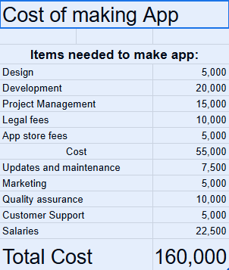
Product/ Idea Price
Price to create app is $160,000 and selling price is $5 to install and $10 for a subscription.
We need 11,000 people to buy and get the subscription to break even.
Notes:
1. Cost of Production Calculation
The cost of production includes Fixed Costs (which do not change with the number of units produced) and Variable Costs (which vary with each unit produced).
Fixed Costs:
Research & Development (R&D): $200,000 per year
Software Development & Maintenance: $150,000 per year
Marketing & Advertising: $100,000 per year
Warehouse & Distribution: $50,000 per year
Salaries (Admin, Support, Sales): $250,000 per year
Other Overheads (Utilities, Insurance): $50,000 per year
Total Fixed Costs = $800,000 per year
Variable Costs (Per Unit):
Hardware Components (Camera, Sensors, Smart Lock): $150
Manufacturing & Assembly: $50
Packaging & Shipping: $20
Cloud Storage & App Maintenance: $10 per user per year
Customer Support: $5
Total Variable Cost per Unit = $235
2. Selling Price Calculation
To determine the selling price, we consider the following:
Target Profit Margin = 40%
Cost per Unit = $235
Selling Price Formula:
Selling Price=Cost per Unit+(Cost per Unit×Profit Margin)\text{Selling Price} = \text{Cost per Unit} + (\text{Cost per Unit} \times \text{Profit Margin})Selling Price=Cost per Unit+(Cost per Unit×Profit Margin) Selling Price=235+(235×0.40)=235+94=$329\text{Selling Price} = 235 + (235 \times 0.40) = 235 + 94 = \text{\$329}Selling Price=235+(235×0.40)=235+94=$329
Selling Price per Unit = $329
3. Break-Even Analysis
The break-even point is the number of units that must be sold to cover all fixed and variable costs, resulting in zero profit.
Break-Even Point Formula:
Break-Even Point (Units)=Total Fixed CostsSelling Price per Unit−Variable Cost per Unit\text{Break-Even Point (Units)} = \frac{\text{Total Fixed Costs}}{\text{Selling Price per Unit} - \text{Variable Cost per Unit}}Break-Even Point (Units)=Selling Price per Unit−Variable Cost per UnitTotal Fixed Costs​ Break-Even Point=800,000329−235=800,00094=8511 Units\text{Break-Even Point} = \frac{800,000}{329 - 235} = \frac{800,000}{94} = 8511 \text{ Units}Break-Even Point=329−235800,000​=94800,000​=8511 Units
Break-Even Point = 8511 Units
Interpretation:
To break even, the company must sell 8511 units of the home security system. Any sales beyond this point contribute to profit.
4. Summary & Insights
Cost per Unit: $235
Selling Price per Unit: $329
Break-Even Point: 8511 Units
Annual Fixed Costs: $800,000
Profit Margin: 40%

Slide 16
Cost Structure and Revenue Stream
Income Statement | Q1 | Q2 | Q3 | Q4
Revenue Add the product of your average sales price and the number of units sold with your other sources of revenue | $ 000 | $ 000 | $ 000 | $ 000
Fixed Costs Design,Development,Legal fees,Project Management. | $ 55,000 | $ 55,000 | $ 55,000 | $ 55,000
Variable Costs Salaries,Updates and maintenance,Marketing,Quality assurance,Customer Support. | $ 50,000 | $ 50,000 | $ 50,000 | $ 50,000
Total Costs Design,Development,Legal fees,Project Management,Salaries,Updates and maintenance,Marketing,Quality assurance,Customer Support | $ 160,000 | 160,000 | 160,000 | 160,000
Profit Deduct the total costs from your total revenue | No money made | No money made | No money made | No money made

Slide 17
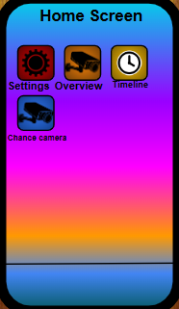
THE PRODUCT User experience
Create an account
You can download HAARV on Google Play or on App Store!
You can click on the cameras section and look at what is happening.
Password:
Fingerprint:
scan
Or Log In
Gmail:
SOS/911 click here
When you click these buttons, you can access certain features.
Cameras:
Customers stay safe and are satisfied that they don’t have to face any problems.
The customer can look at the cameras whenever they want.
As long as you refill the batteries of your cameras and other components, you can use the cameras with no problem.
Backyard:
Frontyard & Inside

Slide 18
Target Audience
Users
Availability
Updates
We expect 18+ years to purchase this product.
We are selling it on:
Google play
and app store
Future update plans include things like increasing camera visibility range.

Slide 19
Consumer Feedback
Alex
Alice
John
The product looks perfect to get robbers not to rob me anymore.
This app is very good. All I have to do is log in to the HAARV app and just look at the cameras to see if someone is there or not! I should get this.
Looking at the idea of HAARV, I want to buy it since it seems really nice.

Slide 20
Thank
you

