Slide 1
MOONBATTLE 1ST SEMIFINALISTS
C counter
SECURITY COUNTER
“Unleashing a security system for justice
1

Slide 2
C counter
SECURITY COUNTER
“Unleashing a security system for justice

Slide 3
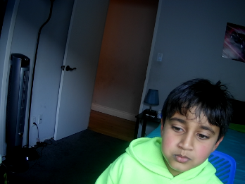
YOUR LOGO
OUR TEAM
TEAM MEMBER’s PICTURE
TEAM MEMBER’s PICTURE
TEAM MEMBER’s PICTURE
Sana
CEO
Ayaansh
founder
Manager
Ayaansh & Sana

Slide 4
Problems & Existing Alternatives
Smart counter installations | They stop being active
Not so good security | Don’t work so good

Slide 5
IDEA
YOUR LOGO
We are making a safe counter to stop people from getting hurt. It has a sensor that detects a firearm such as a gun. When detected, an alarm will start using an LED and a buzzer and counting how many people are in the store.

Slide 6
YOUR LOGO
Solution
WE MADE AN ALARM SYSTEM WHICH WILL BE INSIDE A FAX MACHINE.

Slide 7
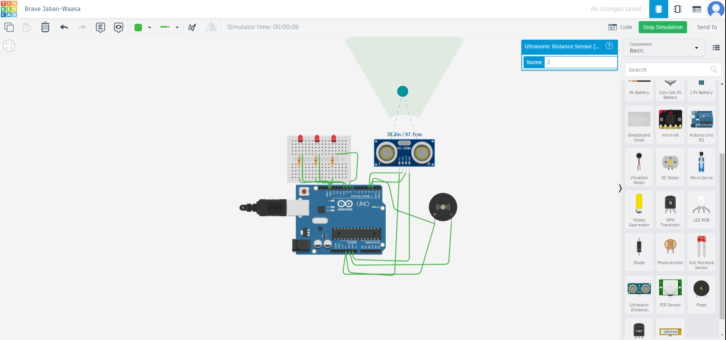
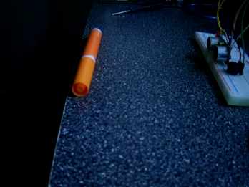
YOUR LOGO
Design & Innovation
A
Key Metric 1
Key Metric 2

Slide 8
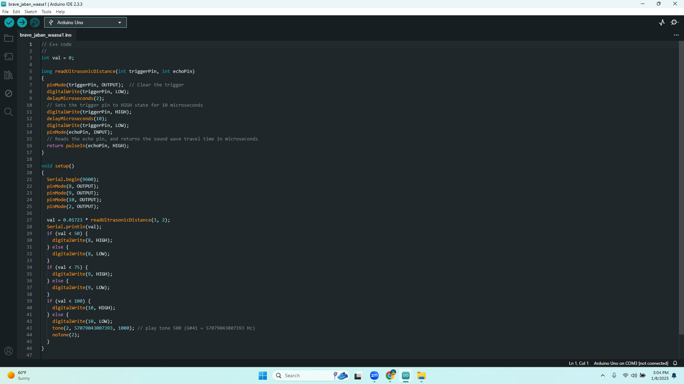

Slide 9
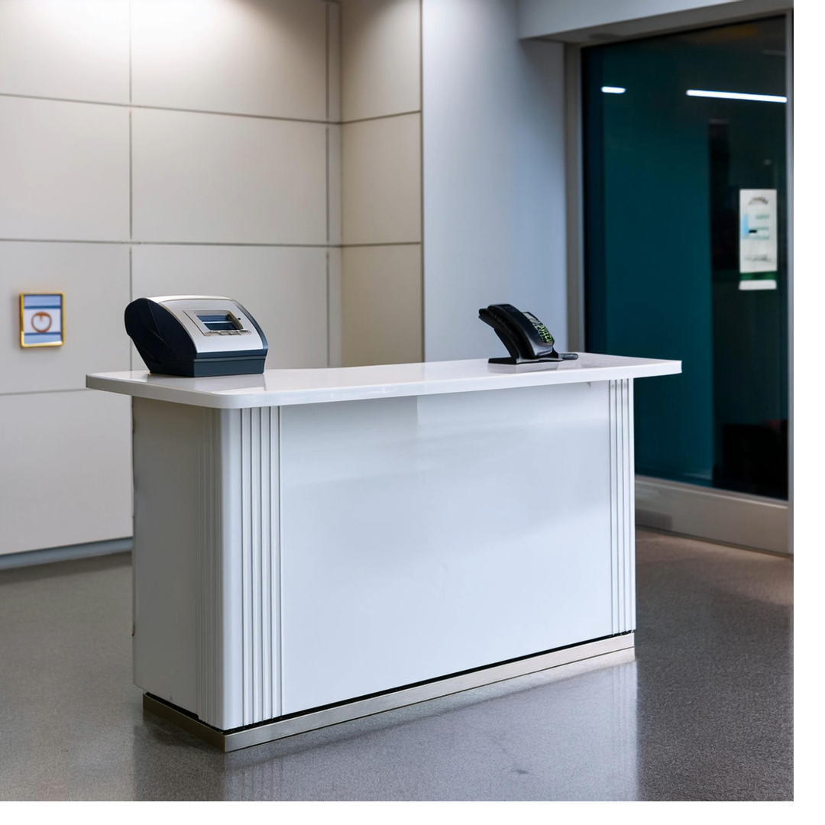
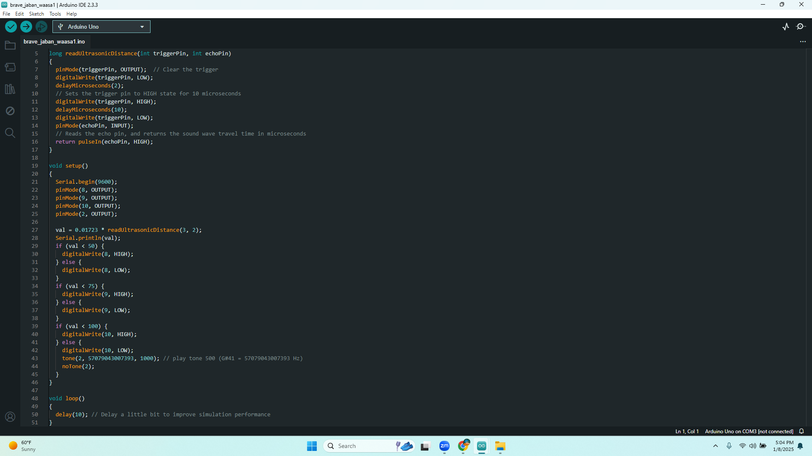
HOW IT HELPS by solving people’s problem.
YOUR LOGO
Feature-1 Pic
Feature-2 Pic
Feature-3 Pic
Feature-4 Pic

Slide 10
PRODUCT DEVELOPMENT ROADMAP
YOUR LOGO
Idea
Making a firearm detector
75%
75%
Design
Making the radius 97.1 cm and 38.2 in And inside a fax machine
We are keeping it in a flat box
75%
Testing We tested it on tinkercad and it worked.
75%
Selling we plan selling it in california los angeles and using partners around the world
75%

Slide 11
YOUR LOGO
The Unique Value Proposition.
MALL OWNERS STORE OWNERS AND PARK OWNERS.

Slide 12
YOUR LOGO
Strengths | Weaknesses | Opportunities | Threats
Security with ultrasonic sensor AND ARE SMART IDEAS | smart counter steals are idea and makes it better. Have better ideas | They run out of ideas and we have time to think on an even better idea. | Are revenue and sale goes down a lot.

Slide 13
C counter
Competitive Analysis
Competitive Edge 1
instead of a entire counter they use something to install in a counter.
Competitive
Edge 2
Competitive
Edge 3
They have more experience than us.
There are companies that are popular.

Slide 14
Market opportunity
Research new markets
Innovative solutions
To add better security so that Every mall is safe even when its closed.
It doesn't just work when employees are working it works even if its closed.
Stay ahead of trends
Seasonal spikes
We are trending it on social media like news apps and more.
For the holiday we will give a $50 dollar discount for people on each of are counters.

Slide 15
C counter
MARKET OPPORTUNITY
TAM
Its USA Because USA has a big population of stores.
SAM
Los Angeles because lots of theme parks are there
SOM
Not so much but later in the year maybe around 70%

Slide 16
C COUNTER
Marketing Channels
Marketing Channel 1 | Marketing Channel 2 MAKE FLIERS | Marketing Channel 3
CREATE A CHANNEL AND SHOW CASE IT |  | POST PICTURES ON INSTAGRAM,FACEBOOK,AND X.

Slide 17
C counter
Product/ Idea Price
CLICK BELOW TO SEE!
COST OF MAKING PRODUCT
Ingredients | Cost
Jumper wire | 6.98
Arduino | 27.6
LED | 4.99
Buzzer | 6.99
Breadboard | 16.99
Cost | 63.55
Salaries | 0.02
Rent | 0.06
Packaging cost | 0.5
Machinery | 0.01
Marketing Cost | 0.6
Total of Making product | 64.74
Selling Price | 250
Profit | 185.26

Slide 18
C counter
Cost Structure and Revenue Stream
Income Statement | Q1 | Q2 | Q3 | Q4
Revenue Add the product of your average sales price and the number of units sold with your other sources of revenue | $25000
Fixed Costs Add your fixed costs, such as salaries, insurance, and rent, among others | $ 185.26
Variable Costs Add your variable costs, such as materials, labor, and insurance, among others | $ 64.74
Total Costs Add your fixed and variable costs | $ 250.00
Profit Deduct the total costs from your total revenue | $ 185.26

Slide 19
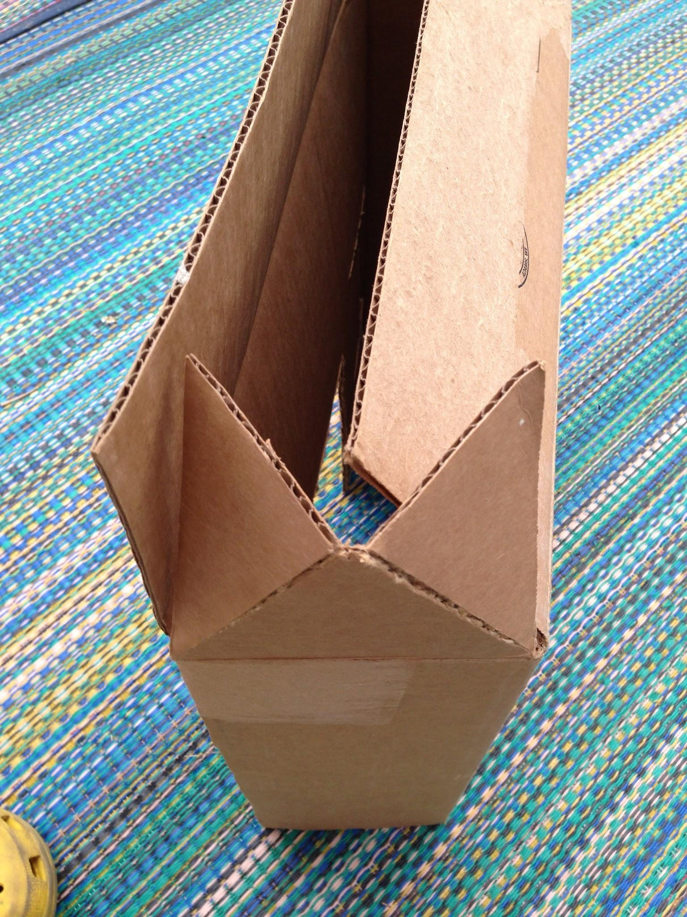
C counter
THE PRODUCT UNBOXING or PACKAGING
Show product in action

Slide 20
C counter
Consumer Feedback
Person1
Person 2
Person 3
We need security on the counters!
it would be better for me to check how many people are at the store.
I think the security should be hidden..

